Slide 1
Thank you for purchasing!
Directions
Print slide 2 for your students to use as a graphic organizer.
As you go through each slide, be sure to discuss the background issues that made each new Compromise necessary. This includes:
Missouri Compromise – First compromise on what to do with western territories. Balance needed to keep both sides happy. Still an aging Thomas Jefferson thought it was the death “knell of the Union” because America could not remain so divided.
Compromise of 1850 – Most of the new territories acquired during the Mexican-American War (1846-1848) were below the Missouri Compromise parallel 36°30′ north. Northern Congressmen wanted to modify the Compromise so that a balance could be kept.
Kansas Nebraska Act - Northern Democrat Stephen Douglas hoped popular sovereignty would enable democracy to decide about slavery, so he would not have to take a side on the issue. The Act was created to open thousands of new farms and allow for a Transcontinental Railroad.

Slide 2
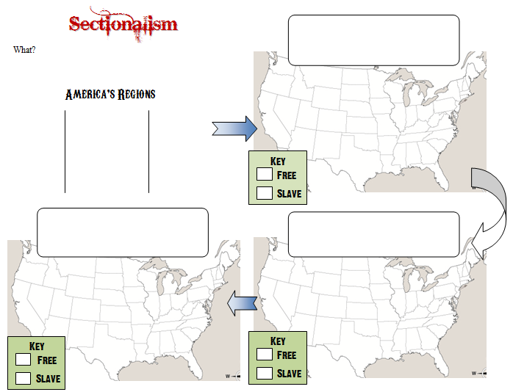

Slide 3
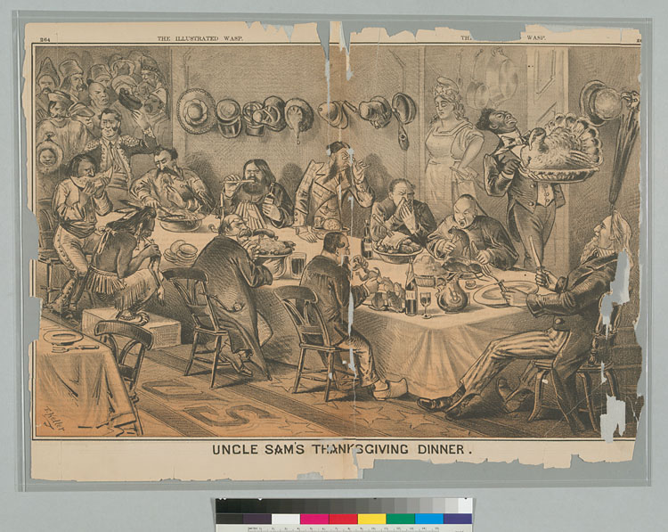
Warm Up
What ethnic groups are at the table?
2. What is the difference between them & Uncle Sam?
3. Is this pro or anti immigration? Why?

Slide 4
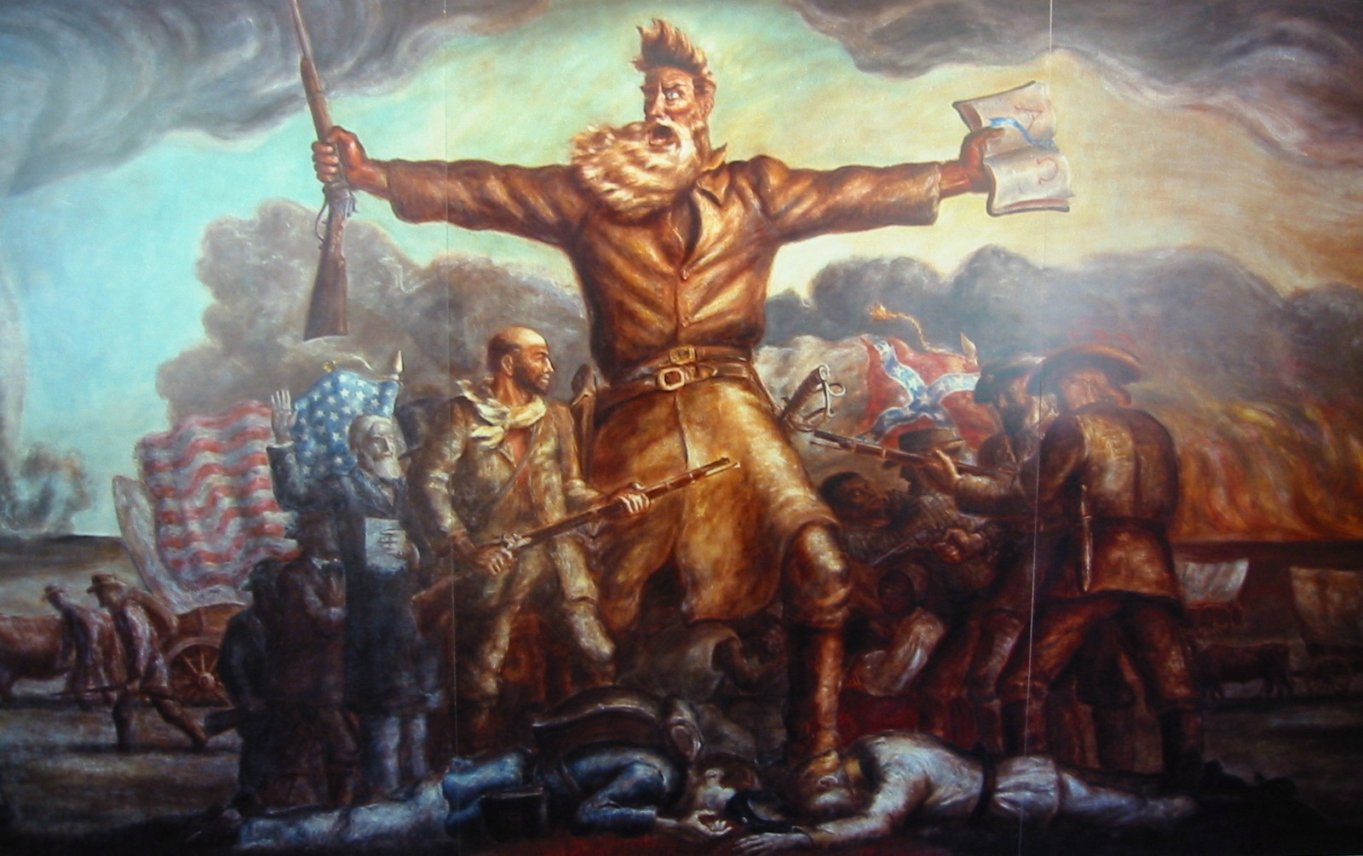
© Students of History - http://www.teacherspayteachers.com/Store/Students-Of-History/

Slide 5
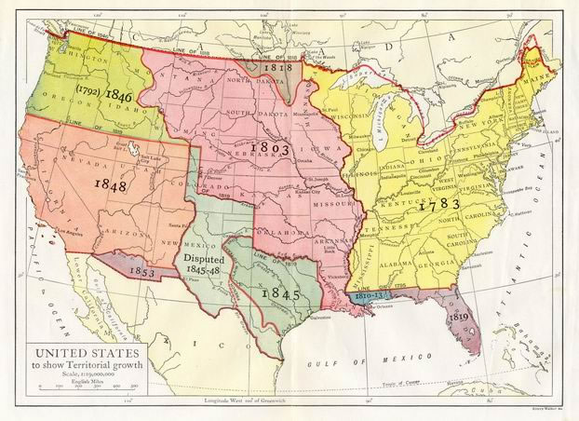
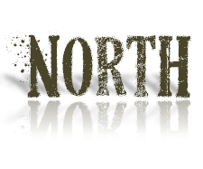
What:
Placing the interests of your region ahead of the nation as a whole
Constantly new settlers
Mining
connected by rail and telegraph
Large cities
Many immigrants
Industry & manufacturing
Economy based on slavery & plantations
King cotton exports bring $$$

Slide 6
1820 agreement on territories entering the Union
East-west line drawn through the Louisiana Purchase
Missouri open to slavery but Maine free to keep balance of free & slave states
Key
Free State
Slave State

Slide 7
California enters as a Free state; Texas is a slave state
Stronger fugitive slave law to be enforced
Slave trade banned in Washington, DC
Key
Free State
Slave State

Slide 8
Popular sovereignty will decide if Kansas and Nebraska are free or slave states
Bloody Kansas – riots across the state during voting
Republican Party forms from Whigs and Free Soil Democrats to oppose slavery
Key
Free State
Slave State

