Slide 1
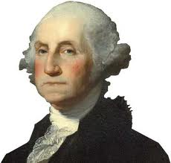
Warm Up
After the constitution was ratified, The Electoral College elected Washington unanimously as the first president in 1789 and again in the 1792 election. He chose Jefferson and Hamilton to lead his first cabinet. John Adams, who came in 2nd in the election became the 1st Vice-President.
What political party did George Washington belong to?
What were his group of advisors called?
How was the Vice President chosen then?

Slide 2
© Students of History - http://www.teacherspayteachers.com/Store/Students-Of-History

Slide 3
America in 1790
Predominantly a rural society
80% of households were involved in agricultural production
750,000 African-Americans (20% of the population)
Most lived in the south; about 10% lived in the North or on the frontier

Slide 4
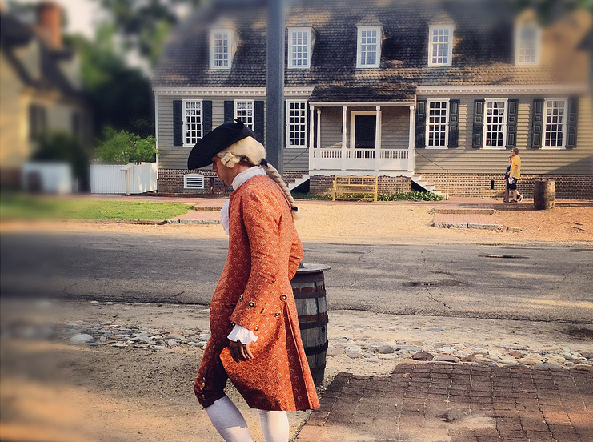
Beginning a New Government
Congress convenes March 4, 1789
Vote for President:
Washington: 69 electoral votes
John Adams: 34 electoral votes (becomes vice president)
Bill of Rights adopted by Congress and then ratified by states in 1791
lukerosa@gmail.com

Slide 5
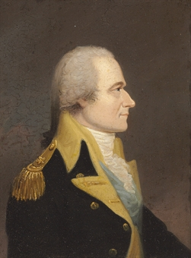
Alexander Hamilton
Federalist & first Secretary of the Treasury in Washington’s cabinet
Said war debt was a national responsibility to be paid by all states, since all benefited
Called for national assumption of states’ debts
This also built a sense of American nationalism
Controversy: Most debt was held by northerners; sharing it didn’t seem fair to the South

Slide 6
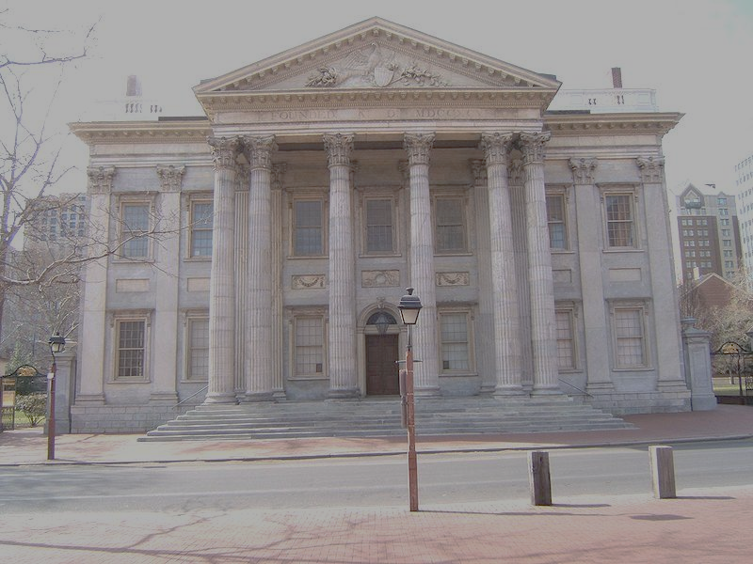
Hamilton & the National Bank
Wanted a bank that would print a national currency and take care of war debt
Would be a source for expanding capital in a growing economy
Argues that the bank is necessary therefore falls under Article I of the Constitution
lukerosa@gmail.com

Slide 7
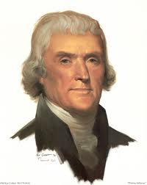
Jefferson & the National Bank
Jefferson argues that the bank does not fall under Article I’s “Necessary & Proper” clause
Madison & Anti-Federalists also led opposition, saying that it was unconstitutional
Northern reps voted 33-1 for bank; Southern reps voted 19-6 against it
Led to question of a strict or broad interpretation of the Constitution?

Slide 8
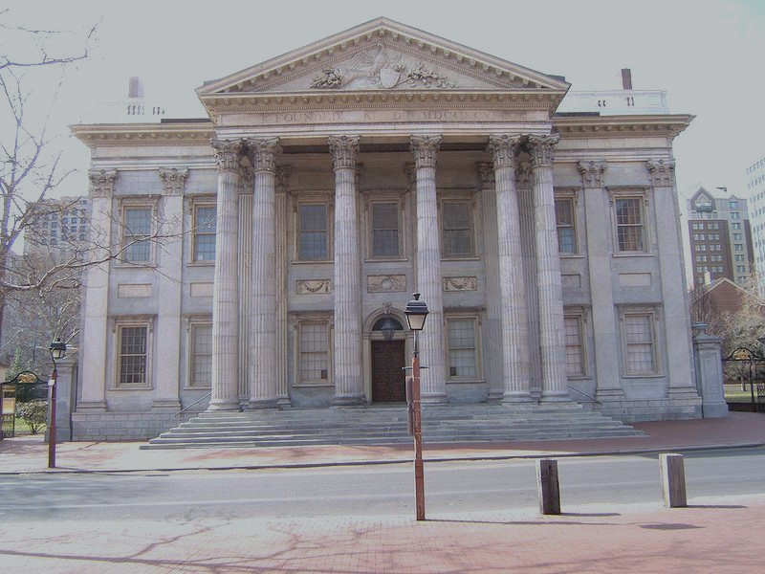
Hamilton & the National Bank
Washington accepted Hamilton’s argument that the gov’t had the right to charter certain institutions whether or not they were clearly defined in the Constitution
National Bank is created; overseen by federal gov’t but 80% financed by outside investors

Slide 9
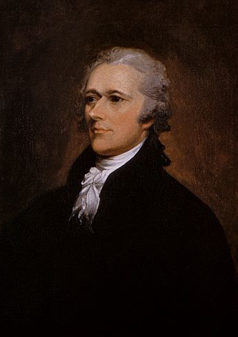
Hamilton’s Legacy
Achievements:
Enhanced value of the dollar
Secured the government’s credit
Attracted foreign capital
Prosperity began to flourish!
Weaknesses:
Never really understood the people of the farms and frontier
Accused of being elitist

Slide 10
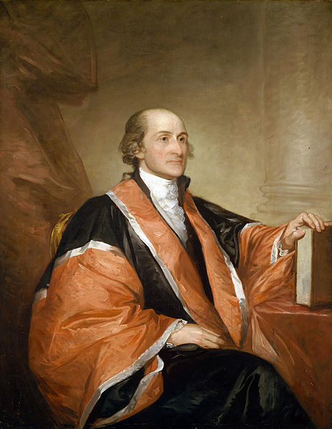
Jay’s Treaty
John Jay sent to England to negotiate:
Stop seizing U.S. ships
Vacate forts on the frontier
Repayment for stolen crops and slaves
Treaty on commerce in the West Indies
Jay returned with only 2 of these met
Treaty is met with outrage but Washington accepts it

Slide 11
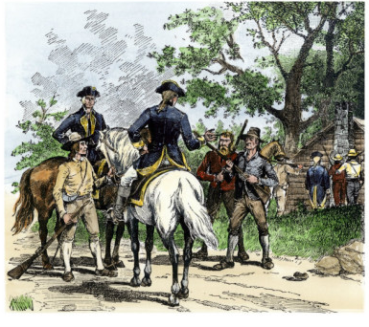
The Whiskey Rebellion
Hamilton’s 1791 excise tax on whiskey angered frontier farmers
Summer of 1794: revolts break out in western PA
Washington calls on the army to suppress the rebellion
Set an example of federal law, authority, and follow-through
Notes:
Whiskey was the farmer’s most profitable commodity so the tax would hurt them quite a bit.

