Slide 1
Warm Up
What president is pictured & what bill is it?
2. How did he feel about a National Bank of the US?
3. What did he do to the National Bank?
Notes:
Answers: 1) Andrew Jackson 2) Hated it – wanted to remove its charter and felt it was a tool of the wealthy elite 3) Removed its charter

Slide 3
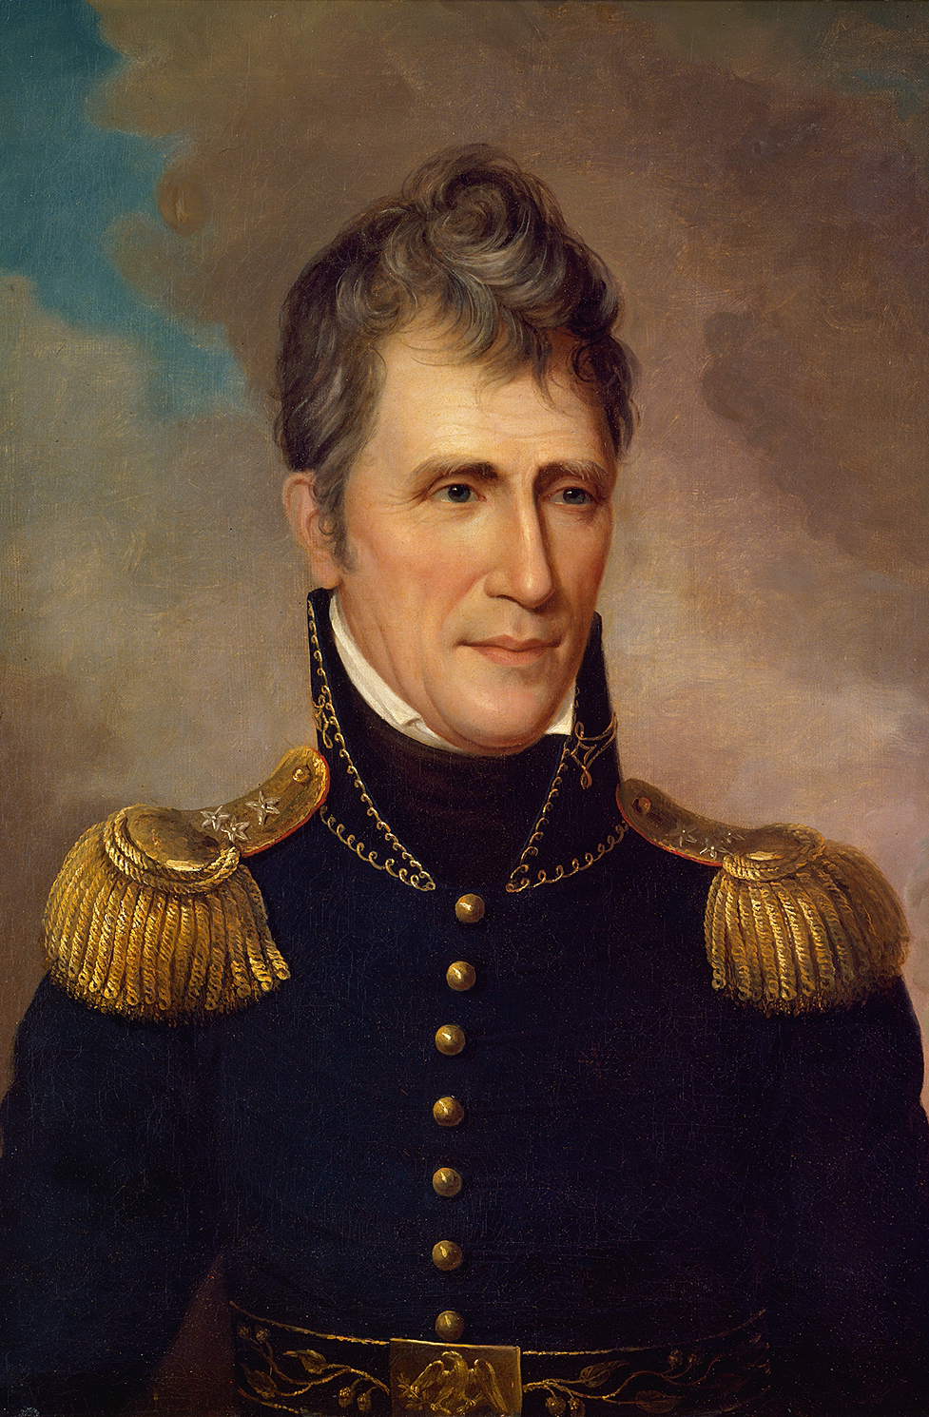
Andrew Jackson
Nicknamed “Old Hickory” for his toughness
Major General during the War of 1812
Wins major victories in the Battle of Horseshoe Bend & The Battle of New Orleans
Leads campaign against Seminole & Creek Indians

Slide 4
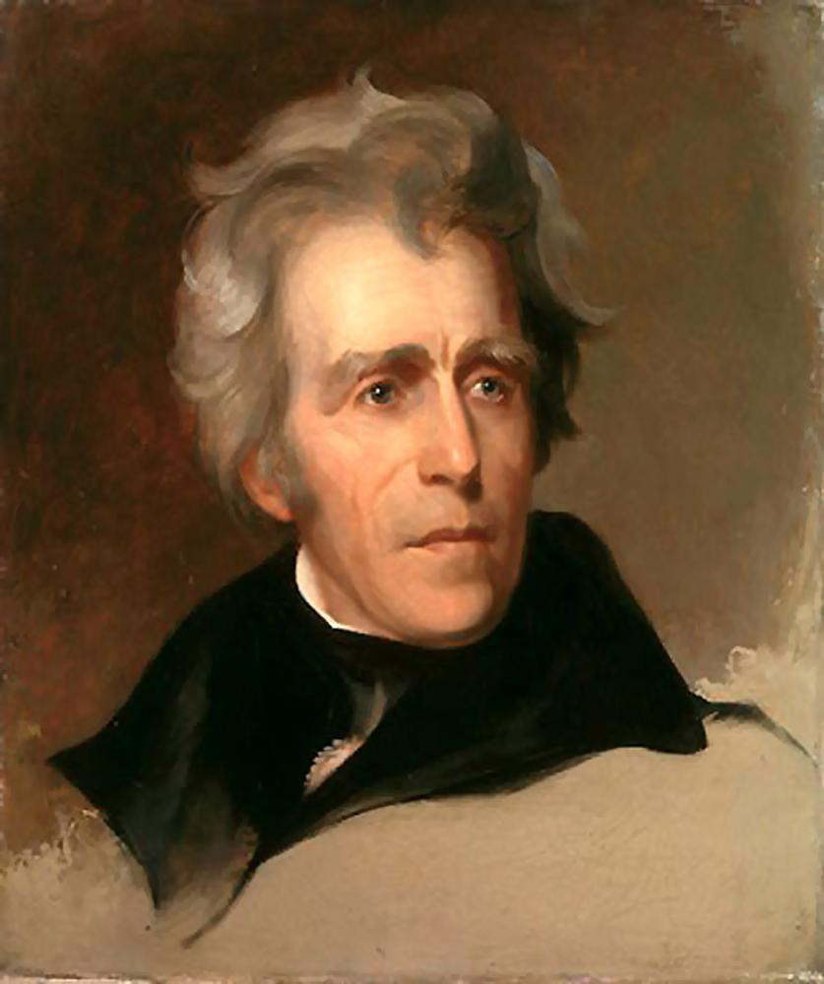
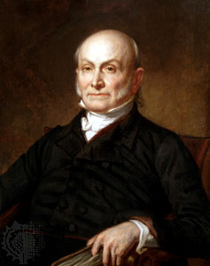
Andrew Jackson
John Quincy Adams

Slide 5
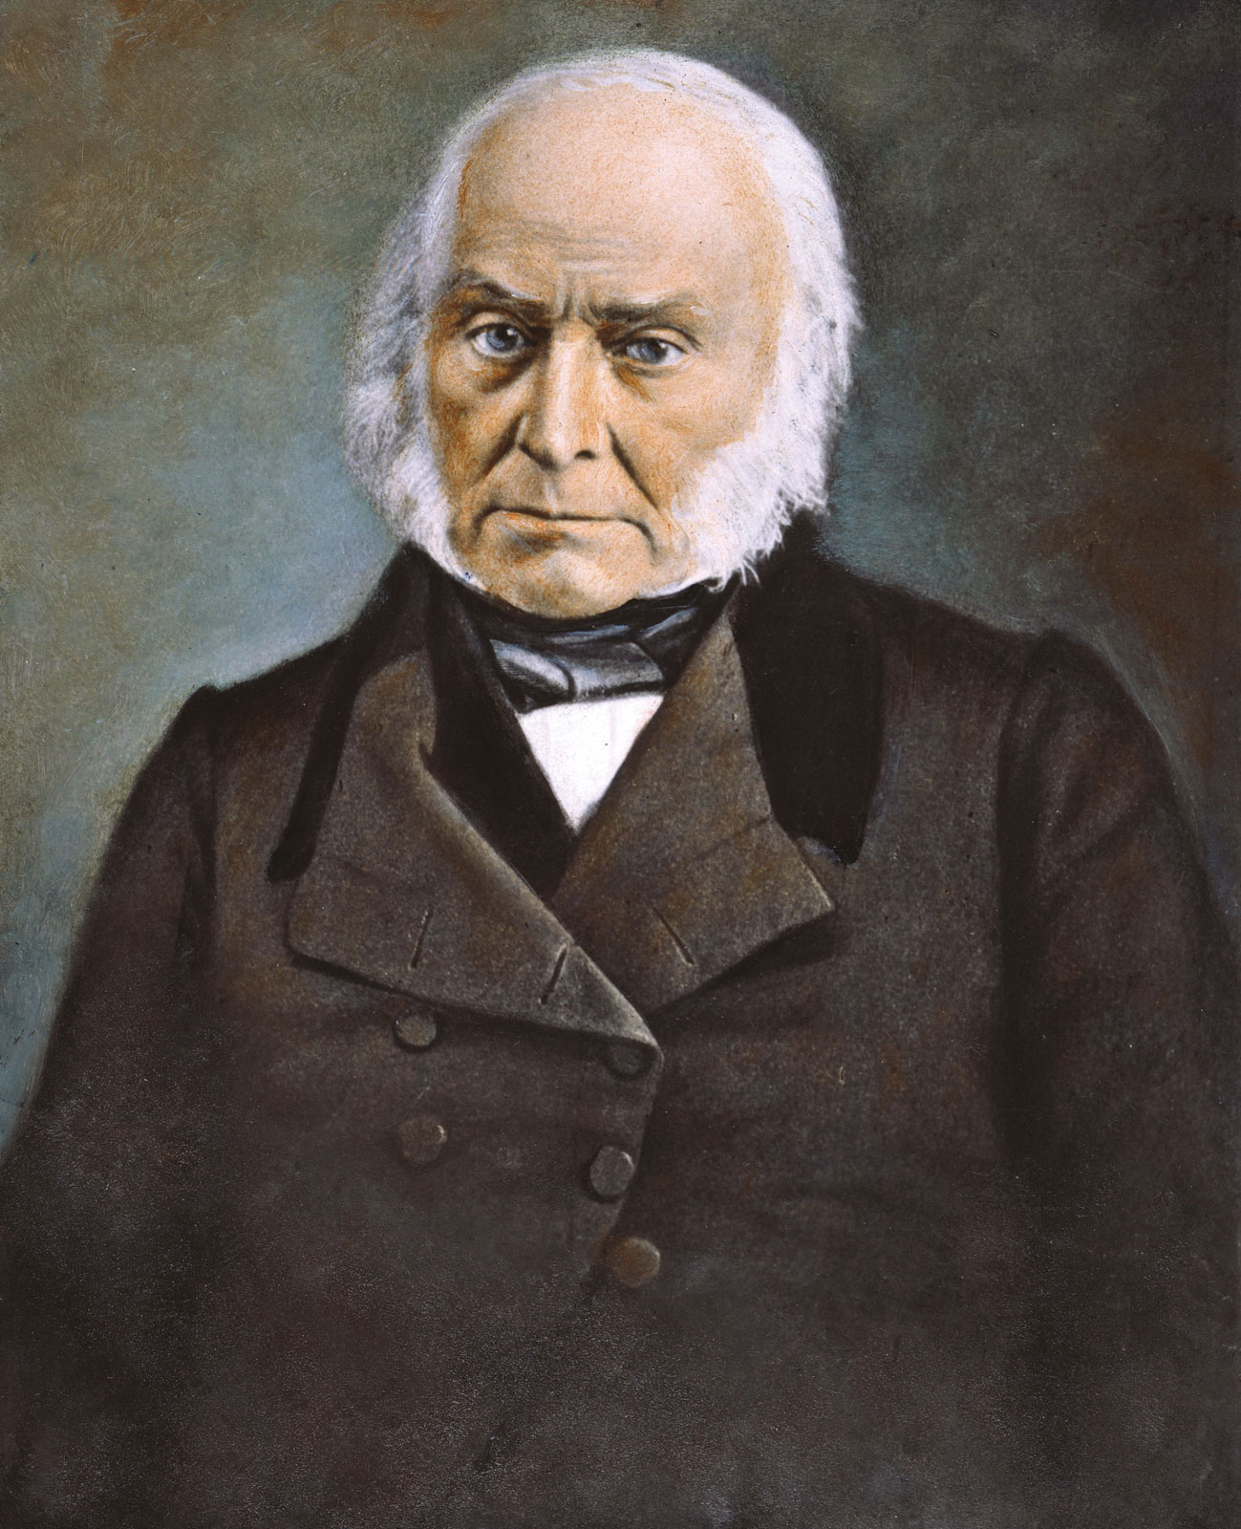
John Quincy Adams
Son of President John Adams
Strong support in New England
Favors internal improvements: National Road, Erie Canal

Slide 6
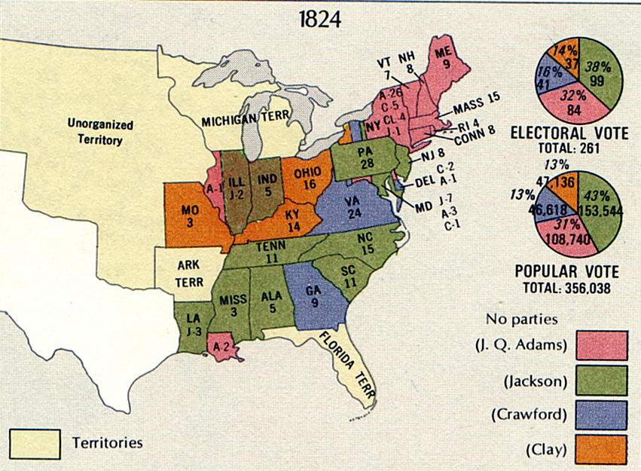
Federalist Party Dissolved
4 Democratic-Republicans run & No one receives majority
Goes to the House of Representatives
Adams is named the next President

Slide 7
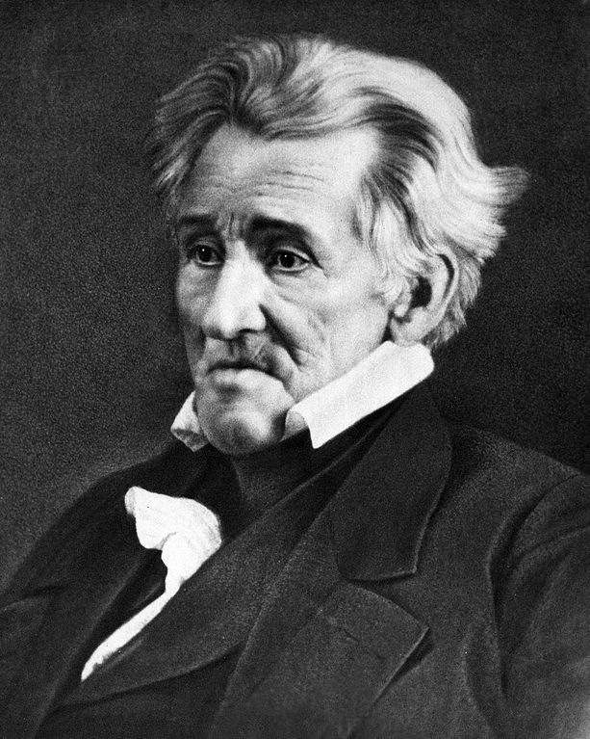
Results
Calls Adams victory a “corrupt bargain”
Seen as a “man of the people”
Supports removing property qualifications for voting

Slide 8
Andrew Jackson
John Quincy Adams

Slide 9
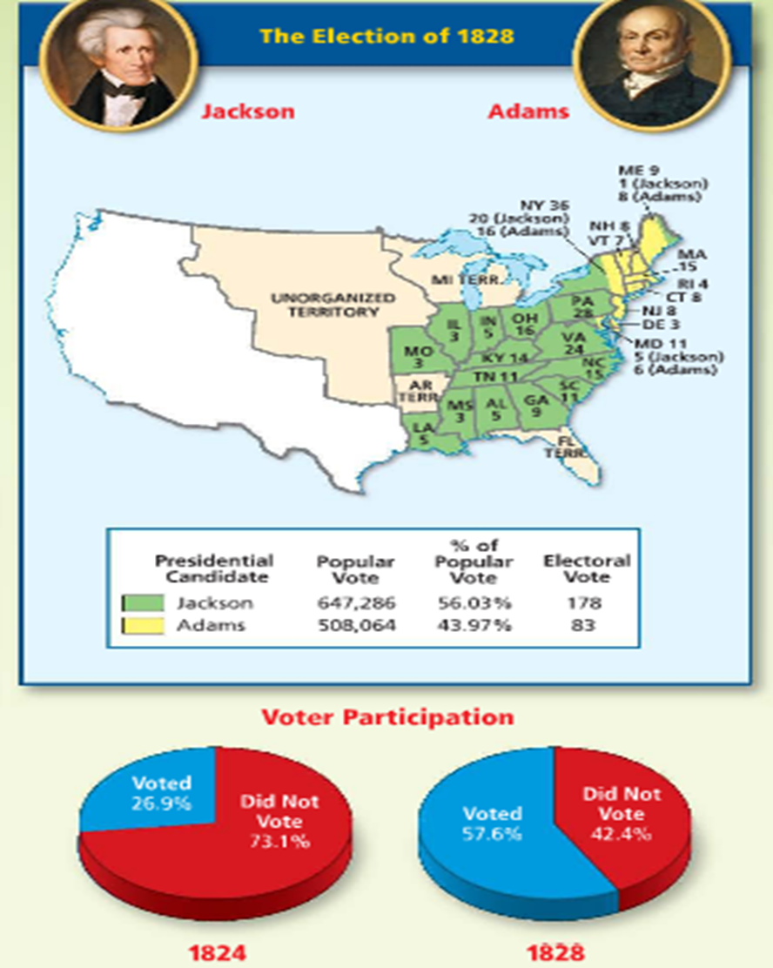

Slide 10
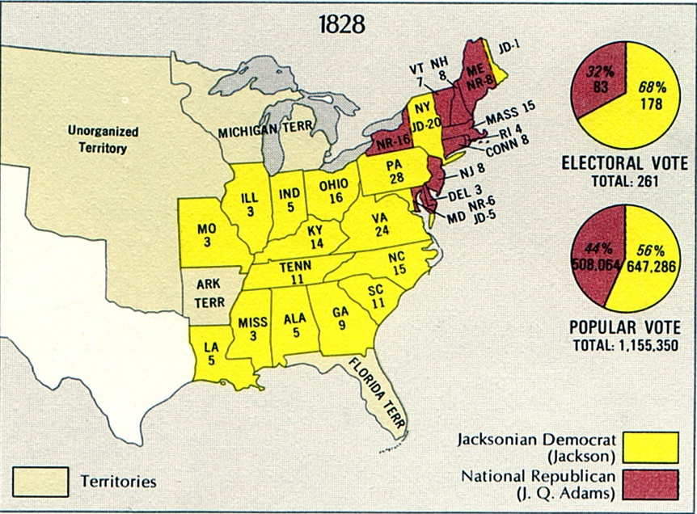
Result: 3 times as many people vote & Andrew Jackson wins

Slide 11
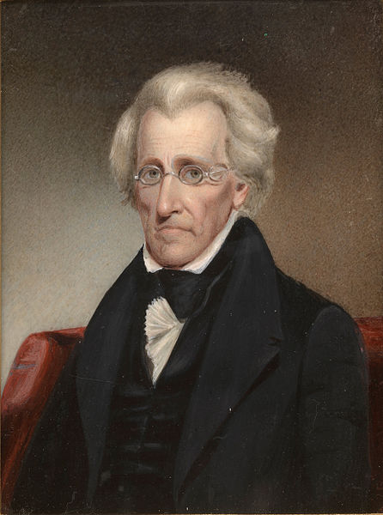
President Jackson
Becomes 7th President
Strengthens the power of the presidency
Takes on many opponents

Slide 12
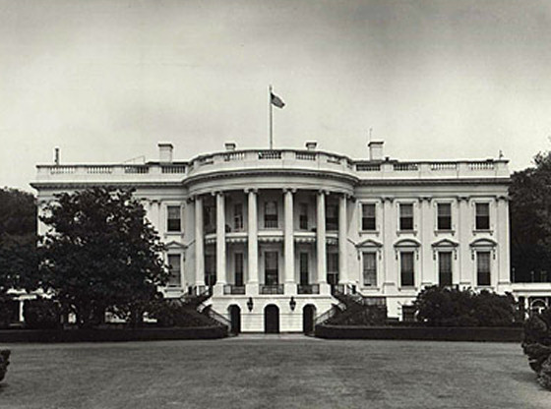
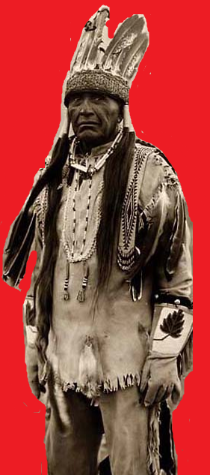
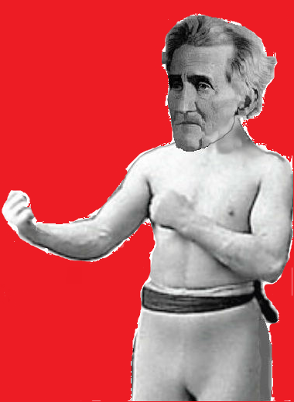
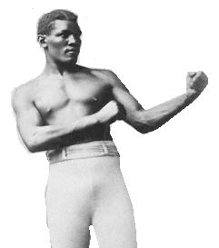
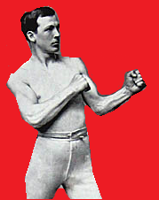

Slide 13
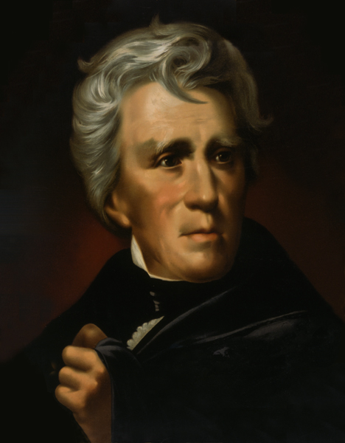
Vs. Bureaucracy
Distrusts DC bureaucrats
Fires hundreds and replaces with his supporters
Rewards his campaign supporters with jobs – The Spoils System

Slide 14
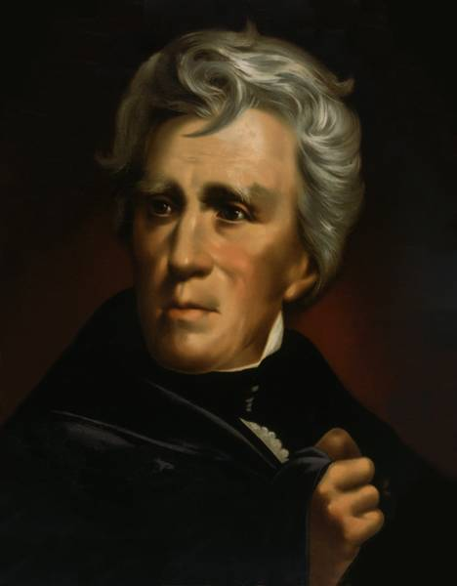
Vs. Native Americans
Passes the Indian Removal Act
“5 Civilized Tribes” forced west to reservations
The Trail of Tears was their route

Slide 15
Vs. The National Bank
Thinks bank is the tool of the wealthy
Vetoes its charter in 1832
Places Federal money in state banks
Causes Panic of 1837

Slide 16
Vs. Nullification
South Carolina does not like the Federal Tariff of 1832
South Carolina claims it can nullify the tariff
Jackson threatens to send military to collect the tariff

Slide 17
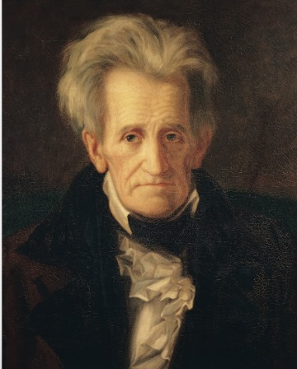
Creation of the modern Democratic Party
Protection of popular democracy
Expanded use of the presidential veto

Slide 18
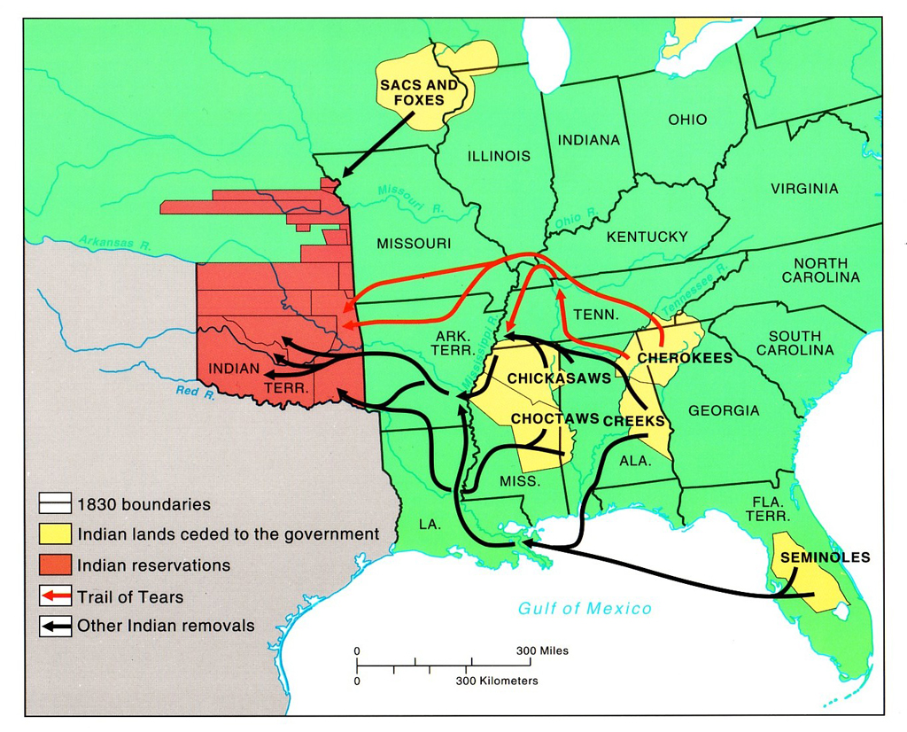
Exit Ticket
In what year was the Indian Removal Act passed?
What Indian tribes were removed?
What current US state were they moved to?

