Slide 1
Early Presidents
WAJMMA

Slide 2
WAJMMA
Q: What is WAJMMA?
A: WAJMMA is the first six Presidents of the United States (POTUS)
Washington
Adams
Jefferson
Madison
Monroe
Adams

Slide 3
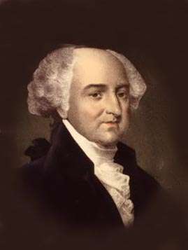
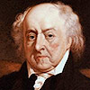
John Adams
Adams was a leader during the American Revolution, Washington’s vice-president, and a diplomat
He was elected in 1796 as a Federalist, defeating Thomas Jefferson by 71 to 68. Jefferson became vice-president.
He was the first president to govern from Washington, DC.
His ELECTION to the office of president was the FIRST peaceful exchange of power (leader of country) in the history of the world!

Slide 4
The XYZ Affair
French ships were seizing American ships on the Atlantic to prevent trade with Britain (France and Britain were at war, remember?)
Adams hoped to avoid a war with France, so he sent three men to deal with the French government.
The diplomats were told by three French agents (called X, Y and Z) that they could only meet with the foreign minister if they bribed the minister and promised to loan $10 Million to France. The American diplomats refused.
Congress canceled all treaties with France, allowed US ships to seize French ships, and started setting aside money for the army and navy.

Slide 5
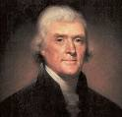
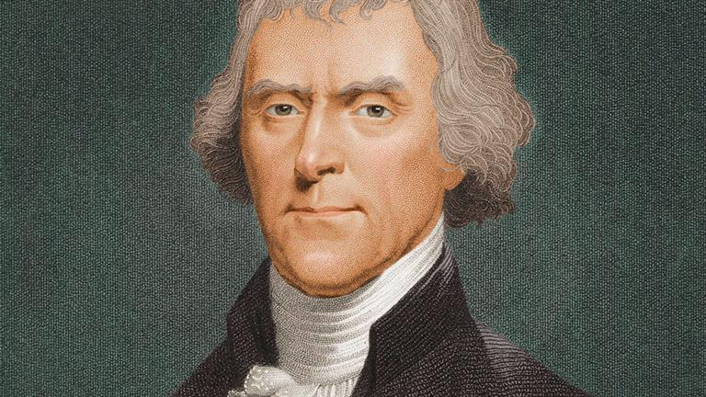
Thomas Jefferson
Wrote the Declaration of Independence
First Secretary of State
Vice President for John Adams
Founder of Democratic-Republican Party
3rd President of United States
Approved the Louisiana Purchase

Slide 6
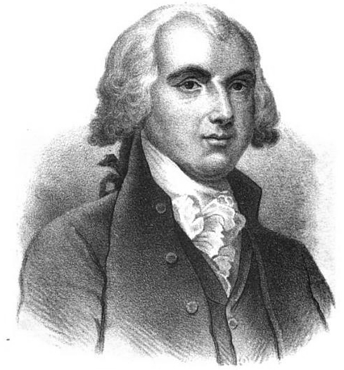
James Madison
“Father of the Constitution,” and was a strong supporter of its ratification
He acted as Secretary of State for Jefferson, and helped arrange the Louisiana Purchase
Elected in 1808 and again in 1812, Madison inherited the problems with Britain.

Slide 7
War of 1812
Madison faced several problems with the British when he took office, especially impressment of American sailors and interfering with American merchant ships
The last straw was when the British supported an Indian revolt against America
Congress declared war against Britain in 1812

Slide 8
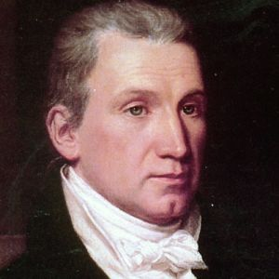
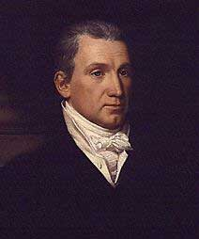
James Monroe
Elected in 1816 and 1820; the Federalist party lost badly in 1816 and disappeared, leaving only one major political party: Democratic Republicans
Settled national boundaries with Canada
Took Florida from Spain
Oversaw the Missouri Compromise
Issued the Monroe Doctrine

Slide 9
Monroe Doctrine
For almost 200 years, the Monroe Doctrine has been a major part of US foreign policy
President Monroe said (in 1823) that the Americas were closed to further colonization by Europe
He warned European countries that if they tried, it would mean war with the US
Finally, he agreed to stay out of European affairs

Slide 10
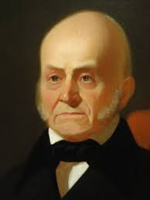
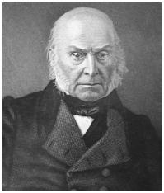
John Quincy Adams
Elected in 1824, he was the son of former President John Adams
He did not win the most popular votes – Andrew Jackson did. No one got a majority of electoral votes. He was chosen by the House, but Jackson called his election a “corrupt bargain.”
His single term as president was not successful, because of opposition from Congress to his plans.
He later was elected to Congress – the only president to win elected office after being president.

