Slide 1
The Civil War

Slide 2
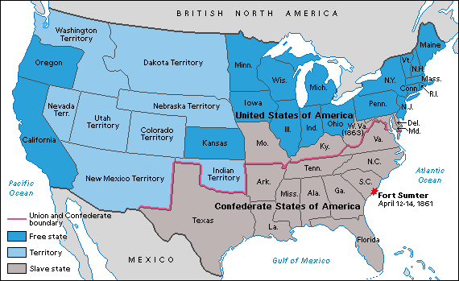
Civil War Map

Slide 3
Advantages
NORTH
More railroad
More factories
More money
More people
Existing army & navy
Functional government
SOUTH
More military schools
Better officers
More athletic or outdoors-y
Simple strategy
Fighting to preserve homes/way of life

Slide 4
Strategy
UNION
“Anaconda Plan”
Blockade the South with the Navy
Take control of Mississippi River, cutting the South in half
Squeeze them into submission (deny the South needed supplies)
CONFEDERACY
Defense: Just don’t lose.
Attrition: Wait for the North to get tired of the war.
King Cotton: Get help from Britain in exchange for cotton
Strategy changes during the war to go on offensive

Slide 5
Grant vs. Lee
Grant
Lee
Born in Virginia
Professional Army officer
Captured John Brown at Harpers Ferry
Resigned from US Army to join Confederate Army
Confederate General
Born in Ohio
Retired from US Army after Mexican War
Volunteered for Civil War
Union General
Elected President of the United States
West Point graduate
Fought in Mexican War
Owned slaves

Slide 6
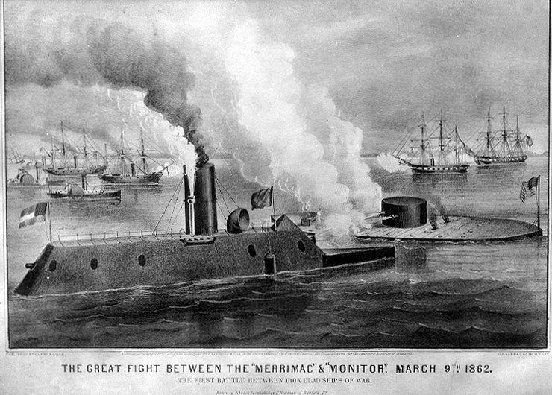
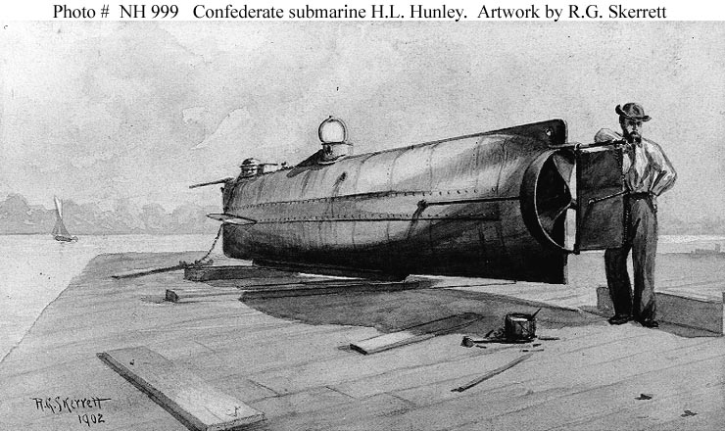
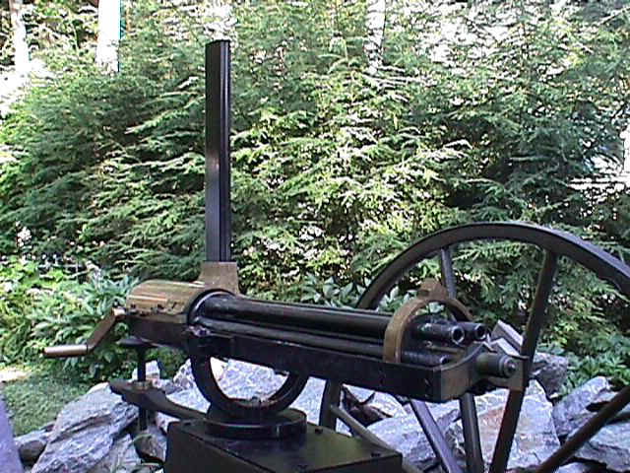
New Technology
Ironclads
Gatling Gun
Submarines
Railroads

Slide 7
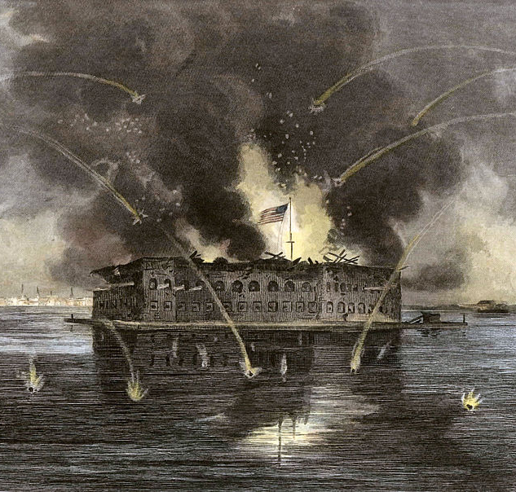
Union fort in South Carolina
President Lincoln sends resources for soldiers trapped in Confederate territory
On April 12, 1861 the Confederates bombarded the fort
The Civil War begins
lukerosa@gmail.com

Slide 8
Lincoln Suspends Habeas Corpus
Habeas Corpus is a law requiring a person under arrest to be brought before a judge or into court
Is this an abuse of presidential power? Do you think because of the war, Lincoln should have the right to do this?

Slide 9
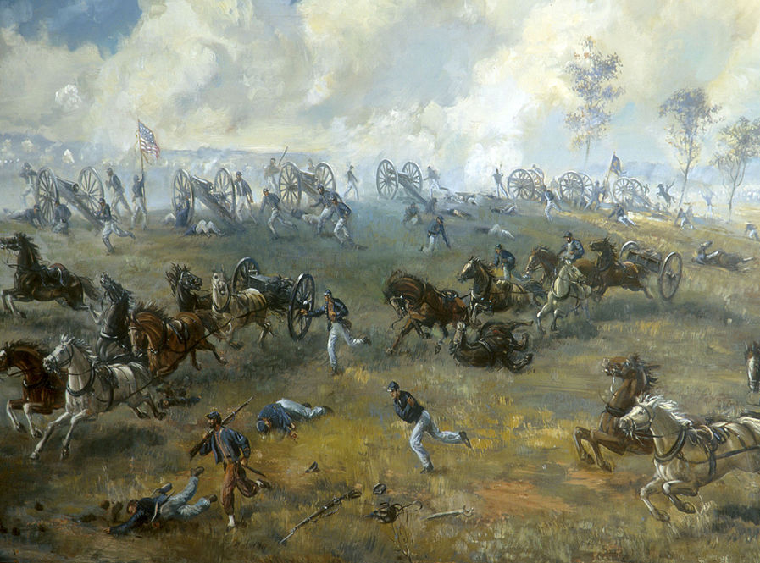
First major land battle of the war
Takes place outside Manassas, VA between DC and Richmond
Shocking defeat for the Union
A larger 2nd Battle of Bull Run will be fought 1 year later

Slide 10
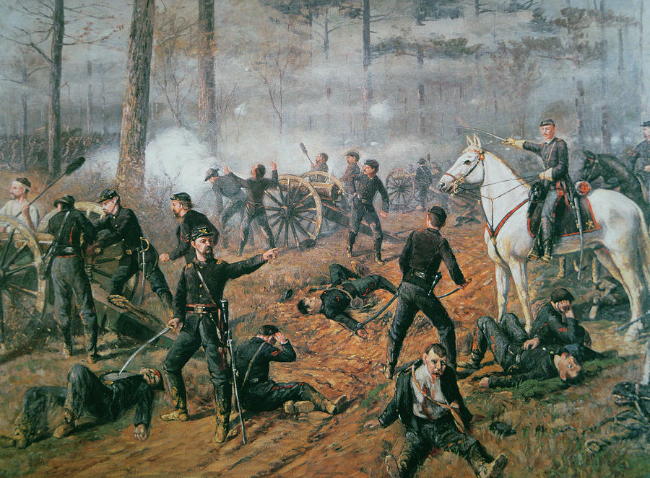
April 1862
Union Gen. Ulysses S. Grant invades Shiloh Tennessee
Bloody battle shows that the North will do what it takes to preserve the Union

Slide 11
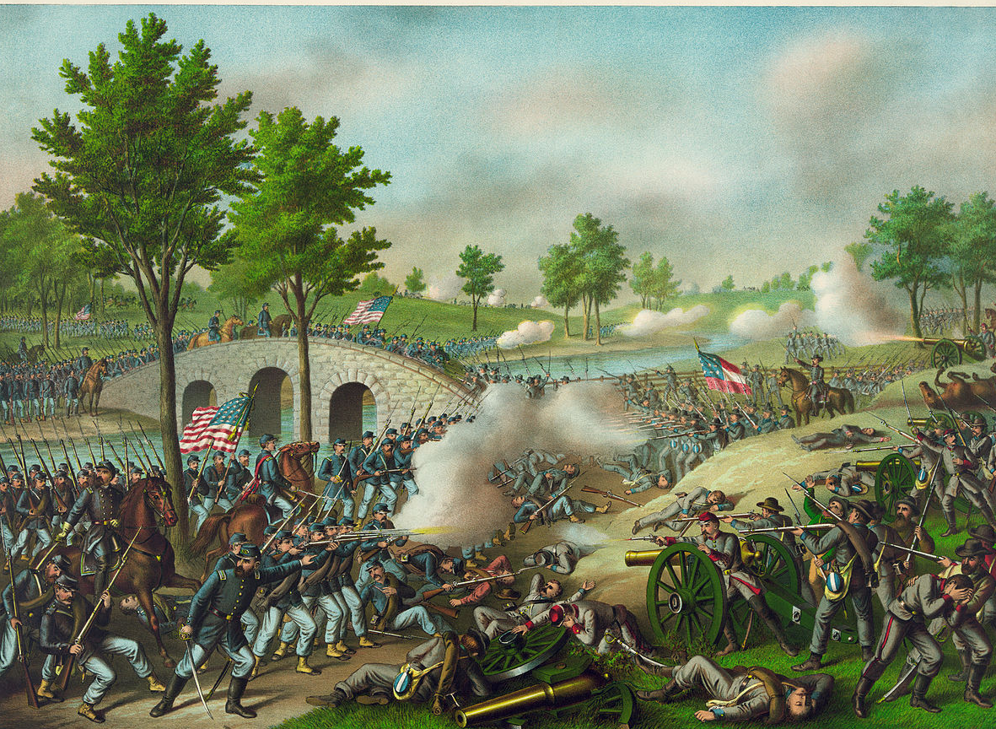
General Robert E. Lee invades Maryland in September 1862
Bloodiest single day in American history – 23,000 casualties
Confederate army retreats back to the South
Union General George McClellan relieved of command in favor of Grant

Slide 12
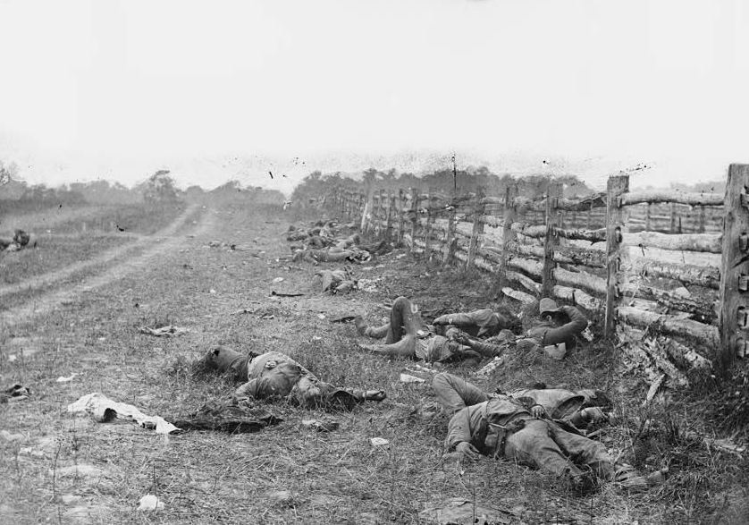

Slide 13
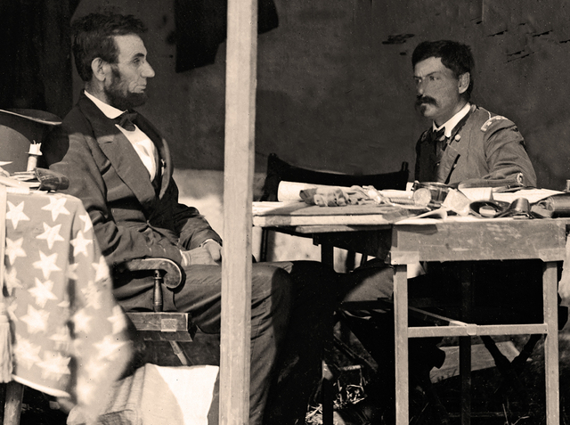

Slide 14
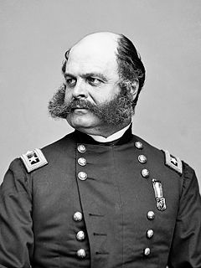
Fredericksburg
After Antietam, Lincoln replaced McClellan with Ambrose Burnside.
McClellan was fired for being timid, so Burnside was very aggressive
With a 2 to 1 advantage in soldiers, Burnside attacks across a river into Southern fortifications
The result is a major disaster: 12,600 Union casualties, with only 5,000 Confederates lost
Burnside doesn’t wait to be fired – he resigns in shame
Ambrose Burnside. More famous for his whiskers (“sideburns”) than his leadership.

Slide 15
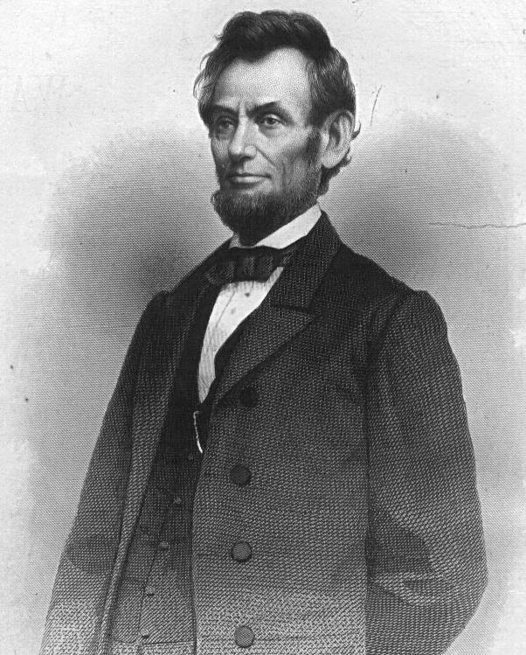
Inspired by small victory, Lincoln frees all slaves in the rebelling states
Has little immediate effect on slavery
Gives the Union a moral purpose for victory
Makes foreign nations unlikely to aid the South
lukerosa@gmail.com

Slide 16
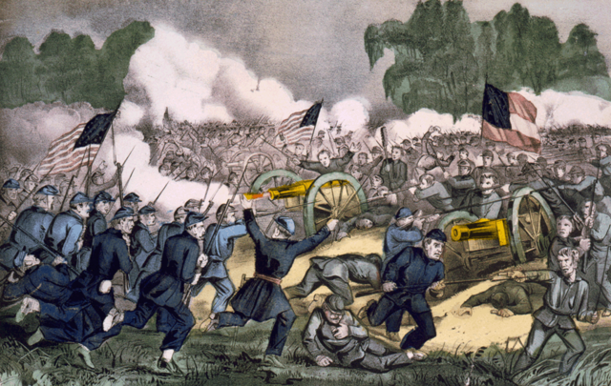
Lee invades Pennsylvania in summer of 1863
Over 3 days in July Union forces defeat Confederate forces
Major turning point in the war

Slide 17
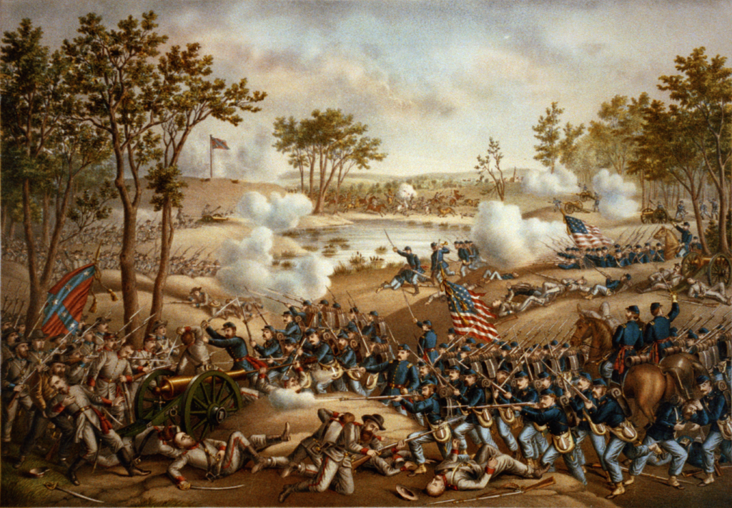

Slide 18
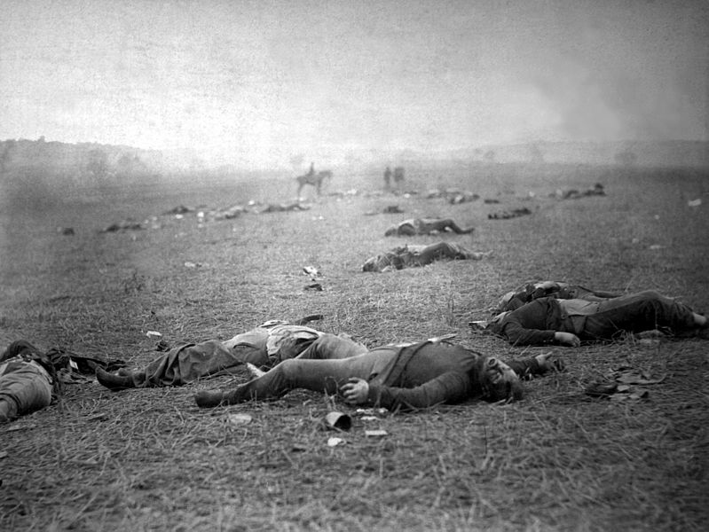

Slide 19
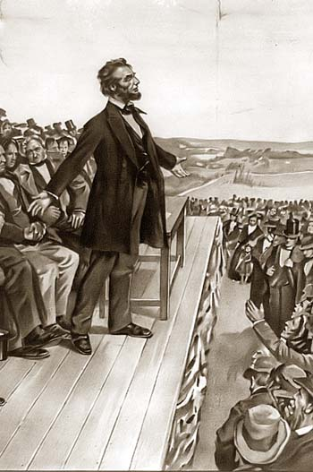
Brief speech at dedication to the battlefield
Lincoln says this is a war to preserve the country
America is not a collection of states but 1 nation of people

Slide 20
Vicksburg
Part of the Union’s “Anaconda Plan” strategy included control of the Mississippi River.
Vicksburg, MS, was the final Confederate stronghold along the Mississippi River.
Union General Ulysses S. Grant surrounded the city in May of 1863. For six weeks, the defenders held out, even though they were starving at the end.
Vicksburg fell on July 4, 1863, the day after the Union victory at Gettysburg. The South was now cut in two.
Grant was brought to the East to fight against Lee as a result of his success at Vicksburg.

Slide 21
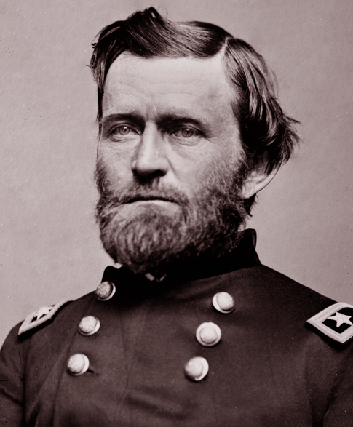
Grant Takes Command
Lincoln was so impressed with Ulysses S. Grant success at Vicksburg he placed him in Command of the Union army.
Grant made his goal “Total War” – destroying everything in the South.

Slide 22
March to the Sea
Lincoln made Ulysses S. Grant the leader of the Union armies in March of 1864.
Grant’s plan included a push through Georgia to the Atlantic coast
Grant chose William T. Sherman to lead the attack
Sherman pursued a plan of ‘total war’, destroying everything that helped the South as his army passed through.
Sherman captured the important port city of Savannah in December, 1864.
General William T. Sherman led the Union Army through Georgia

Slide 23
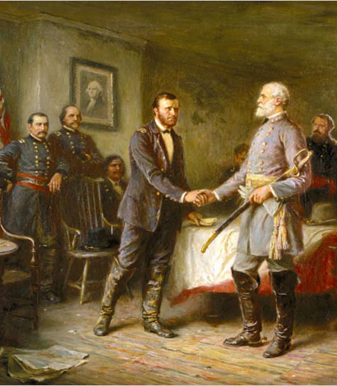
April 1865
Gen. Lee surrenders his Army of Northern Virginia
Gen. Grant accepts his surrender on April 9th

Slide 24
The War Comes to an End
Lincoln’s Second Inaugural Address
The focus in Lincoln’s 2nd Address (1865) was not on preserving the Union as before, but on the sin of slavery.
In April 1865, Richmond, the capital of the Confederacy, fell to the Union.
A few days later Lee met Grant at Appomattox Court House to surrender.

Slide 25
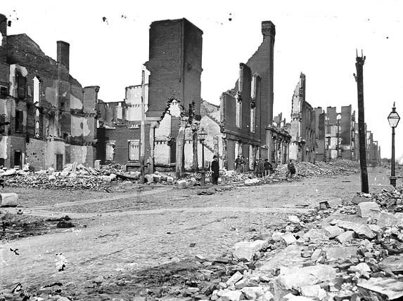
America is reunited
The era of Reconstruction begins in the South
Assassination of Abraham Lincoln

Slide 26
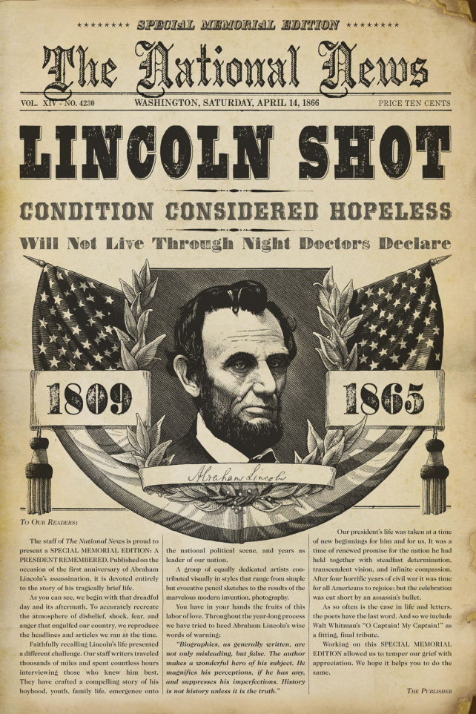
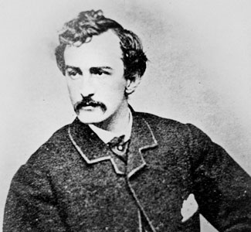
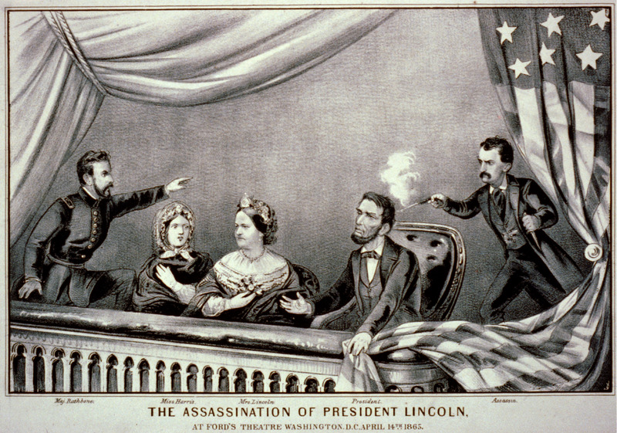
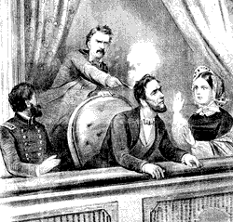
Lincoln’s Assassination
President Lincoln was assassinated at ford’s theater in Washington, D.C. just weeks after the surrender.
He was shot in the back of the head by actor John Wilkes Booth.
Lincoln’s plan was to forgive the South and work together as Americans to rebuild our country, “with malice towards none.”

