Slide 1
Warm Up 5/16
What do you already know about Abraham Lincoln and the Civil War?

Slide 2
Douglas V. Lincoln
Election of 1860

Slide 3
Issue: Slavery in the South
Candidate A:
Supports slavery where it already exists

Slide 4
Issue: Slavery in the South
Candidate B:
Supports slavery where it already exists, fought hard for popular sovergnity.

Slide 5
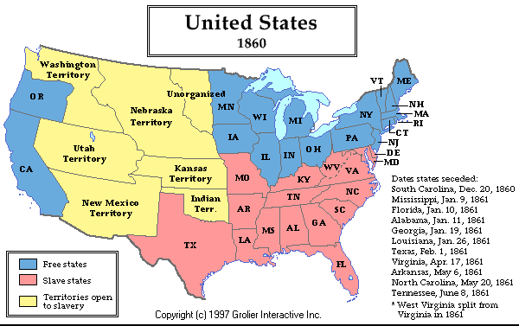
Issue: Slavery in the Territories
Candidate A: Oppose the Spread of slavery to territories

Slide 6
Issue: Slavery in the Territories
Candidate B: Supports Supreme Court decision for slave owners to be free to take their slaves to new territories at their own discretion.

Slide 7
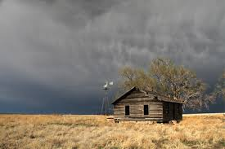
Issues: Homesteads
Homesteads: Government giving land in the open territories to farmers for free
Candidate A: Strongly supports homesteads for free farmers

Slide 8
Issues: Homesteads
Homesteads: Government giving land in the open territories to farmers
Candidate B: Says he supports homesteads, but his party has a history of opposition to homesteads

Slide 9
Issue: Tariffs on Manufactured Goods
Candidate A: Favored high tariffs while in congress
Tariff: a tax to be paid on a particular class of imports or exports
His campaign slogan was “protection for American industry.” Because the tariff was unpopular in farm states, the part sought to link the homesteads and tariffs with the slogan “Vote yourself a farm– Vote yourself a tariff.”

Slide 10
Issue: Tariffs on Manufactured Goods
Candidate B: while in congress, has worked to dramatically lower tariff. Was against increase in Tariff.

Slide 11
Issue: Building a Transcontinental Railroad
Candidate A: Believed the Federal Government should immediately aid in the construction of a railroad. Top Priority.

Slide 12
Issue: Building a Transcontinental Railroad
Candidate B: Supports the idea of a railroad, but not necessary a job for the federal government or a top priority

Slide 13
Time to Vote!
Go through the issues and check the box next to the candidate you support. Answer question #1 with Candidate A or Candidate B.

Slide 14
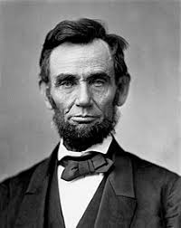
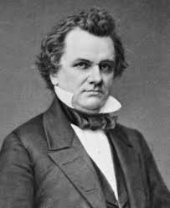
Candidate A: Abraham Lincoln
Candidate B: Stephen Douglas

Slide 15
