Slide 1
Colonies!

Slide 2
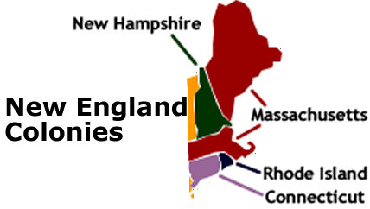
New England Colonies
Massachusetts, Rhode Island, Connecticut, and New Hampshire

Slide 3
Government
Each Colony set up their own Government
English Monarch is ultimate ruler
System of Representative Government
Only land owning, white, men can vote. (church going in Puritan society.)

Slide 4
Religion
Massachusetts and New Hampshire largely dominated by Puritans
Rhode Island and Connecticut set up as havens for those either banished from or willingly left Puritan Society.
Puritans were very strict, lived plainly, wore simple clothes and spent their time in church.

Slide 5
Economy
Made money in: Timber, Fishing, Furs, Whaling, Ship-building industries
Manufactured goods come from England

Slide 6
Notable People, Places and Events
Salem Witch Trials-1692
John Winthrop- Founder of the Massachusetts Bay Colony

Slide 7
Geography
Rocky Soil-makes planting crops difficult
Short growing season
Harsh winters- help to stop spread of disease
Dense forests
Mild Summers

Slide 8
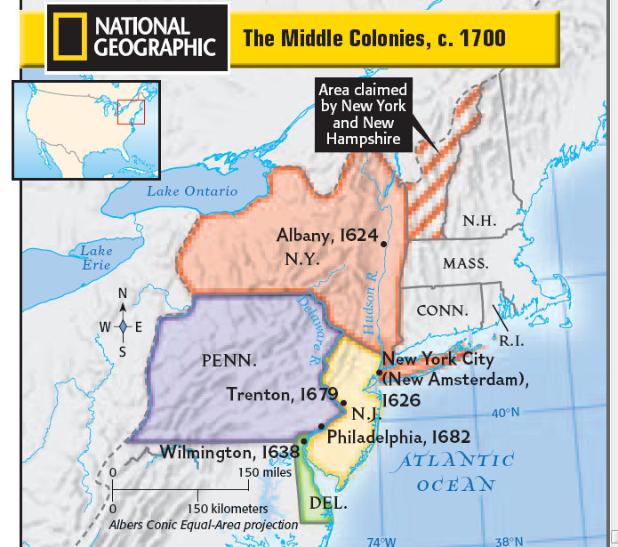
Middle Colonies
New York, Pennsylvania,
New Jersey, Delaware

Slide 9
Government
Representative governments in most colonies
Pennsylvania was more democratic and treated Native Americans better

Slide 10
Religion
Religious Tolerance in all colonies

Slide 11
Economy
“Bread Basket” –grew wheat as a cash crop
Trading center between Southern and New England Colonies
Fishing and ship building were included, but not as abundant as in the New England Colonies

Slide 12
Notable People, Places, and Events
Ben Franklin and Horatio Gates
New York City and Philadelphia became trade centers.

Slide 13
Geography
North
Dense forests
Short growing season
Much like New England Colonies
South
Fertile Soil
Longer summers and growing season
Mild winters

Slide 14
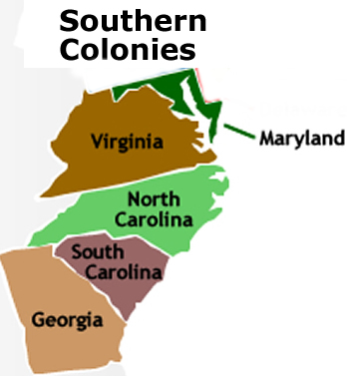
Southern Colonies
Maryland, Virginia,
North Carolina,
South Carolina,
Georgia

Slide 15
Government
Maryland-Proprietary Government
Governors appointed by monarch make all decisions for Colony
Others- Royal government
King makes all final decisions, however, there are councils set up for a small representative government body.

Slide 16
Religion
Religious Freedom in all colonies except Maryland
Maryland is set up as a Catholic Haven

Slide 17
Economy
Cash Crops- Tobaccos, rice, indigo, cotton
Mostly farming
Slaves Plantations

Slide 18
Notable People, places, and events
John Rolfe- tobacco
Lord Baltimore- set up Maryland
James Oglethorpe- Changed Georgia from prison colony
Triangle Trade (slave trade)
Jamestown- first successful English colony

Slide 19
Geography
Very Fertile Soil
Mild Winters
Long Growing Season
Swamp areas
Large Rivers

Slide 20
