Slide 1
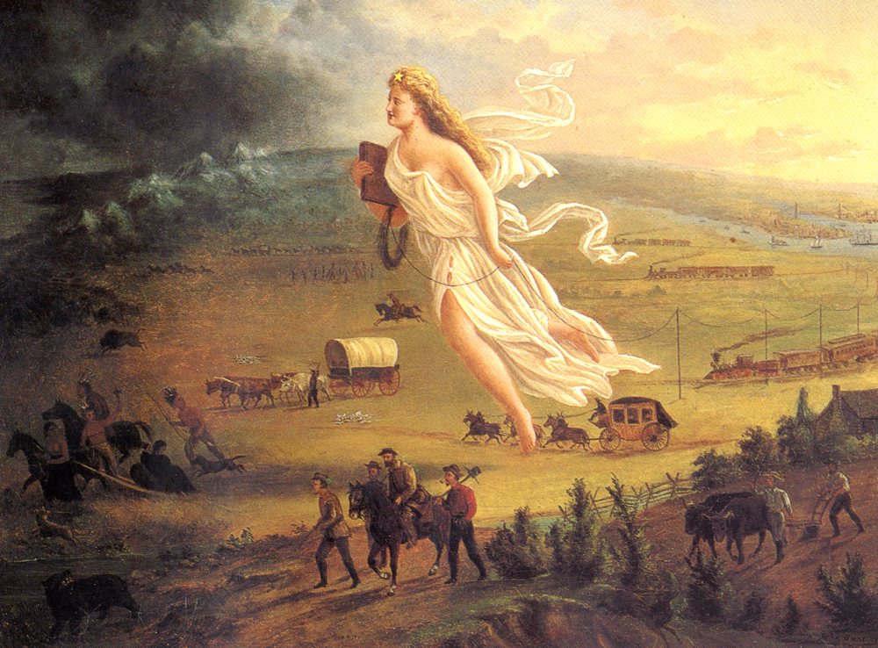
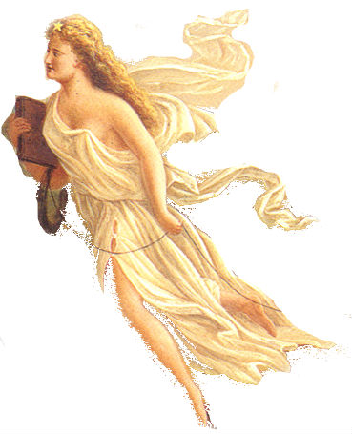

Slide 2
Cowboys
Herding cattle from Texas to Kansas
Take the Chisolm Trail North
Railroad Workers
Irish & Chinese immigrants
Dangerous & difficult work
Mormons
Brigham Young leads Mormons to Great Salt Lake
Found Utah for religious freedom
Exodusters
Former slaves escaping the South
Head to Kansas due to legend of John Brown
Farmers
Moving west for land
Homestead Act (1862) gives acres of land for free to settlers
49ers
Gold discovered outside San Francisco, CA in 1848
Gold rush begins in 1849
Native Americans
Forced further west
Constrained to reservations

Slide 3
Definition: The belief in the 1800‘s that the US was destined by God to expand across the continent, from the Atlantic to the Pacific Ocean.
Cowboys
Railroad Workers
Mormons
Farmers
Exodusters
Native Americans
49ers

Slide 4
© Students of History - http://www.teacherspayteachers.com/Store/Students-Of-History

Slide 5
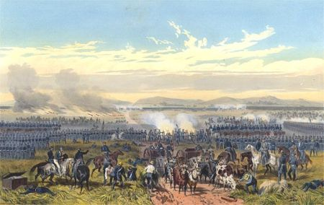
Mexico wins independence from Spain in 1821
Americans begin settling Mexico’s northern border (Texas) but retain US customs

Slide 6
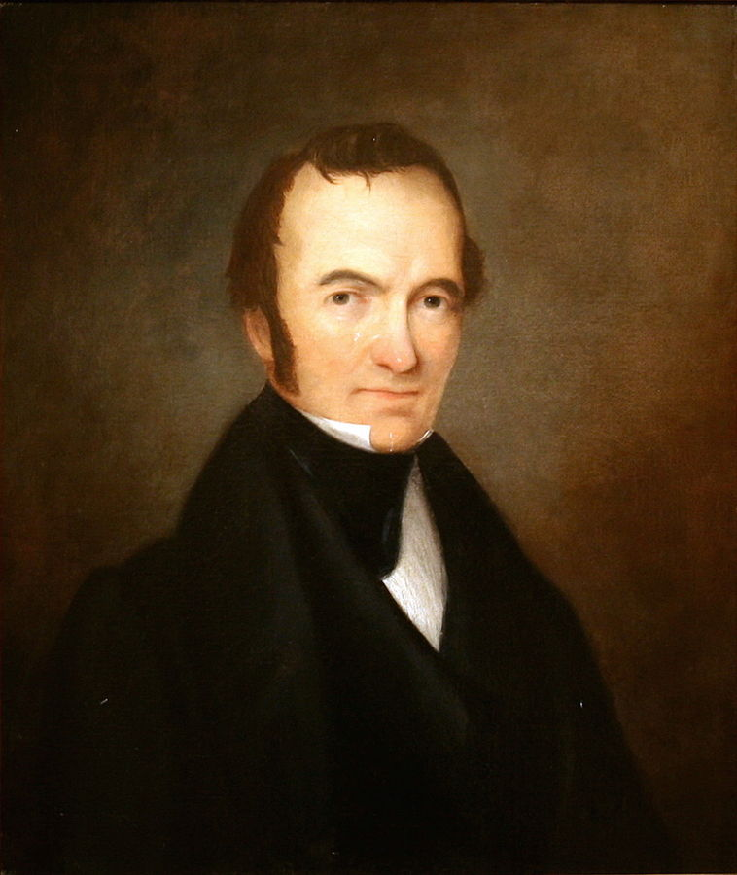
Empresario from Virginia who was granted he right to start a colony in Mexico
Brought 300 families to Mexican Texas in 1825
Notes:
Empresario is the Spanish word for someone granted the right to settle on land in exchange for recruiting and taking responsibility for new settlers.

Slide 7
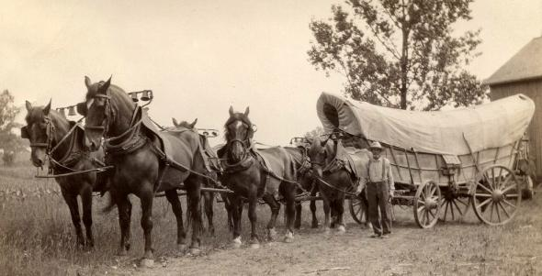
The colony’s success brings more settlers from the US
Soon Americans outnumber Tejanos 6-1
The Mexican government actions begin to upset American settlers:
Dominance of Roman Catholic Church
Mexican citizenship & Spanish language
Mexico outlaws slavery in 1829

Slide 8
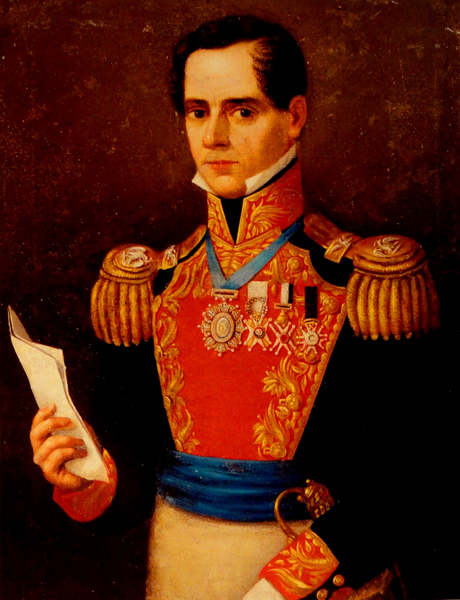
In 1829, Mexico closes Texas to American immigration
Texans must start paying taxes to Mexico
Many begin wishing to break away from Mexico
Mexico’s president Antonio López de Santa Anna sends troops to end the revolt

Slide 9
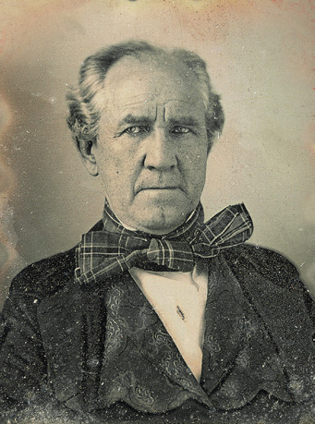
Texans clash with Santa Anna’s army
Sam Houston & Texan leaders declare Texas independent in 1836 by signing the Texas Declaration of Independence

Slide 10
Texans retreat to an old mission (Church) in March 1836
For 12 days, 150 people held off an army of 6000
183 Texans were killed by Santa Anna’s army – killed all men there
“Remember the Alamo!” becomes the famous battle cry

Slide 11
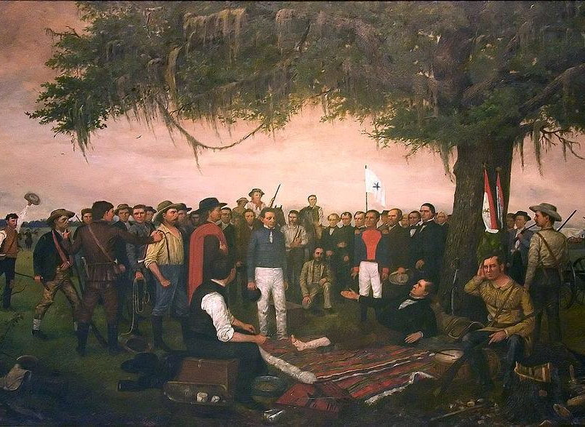
Sam Houston leads Texian army to decisive victory in April 1836
Santa Anna is captured and signs treaty agreeing to leave Texas
Notes:
Painting shows the "Surrender of Santa Anna" by William Henry Huddle shows the Mexican president and general surrendering to a wounded Sam Houston, battle of San Jacinto

Slide 12
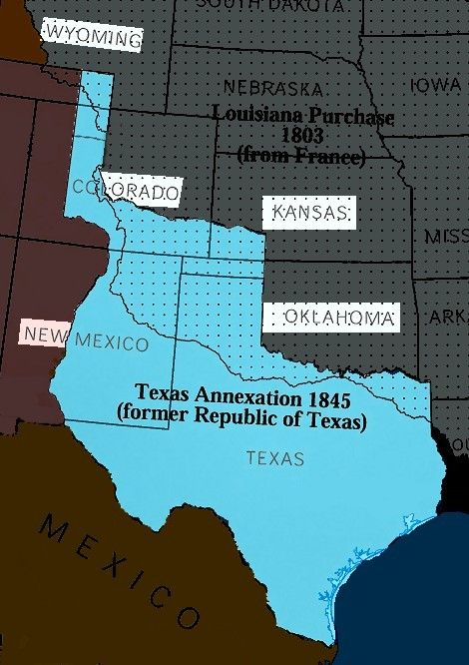
Texas is technically a sovereign nation from 1836-1846

Slide 13
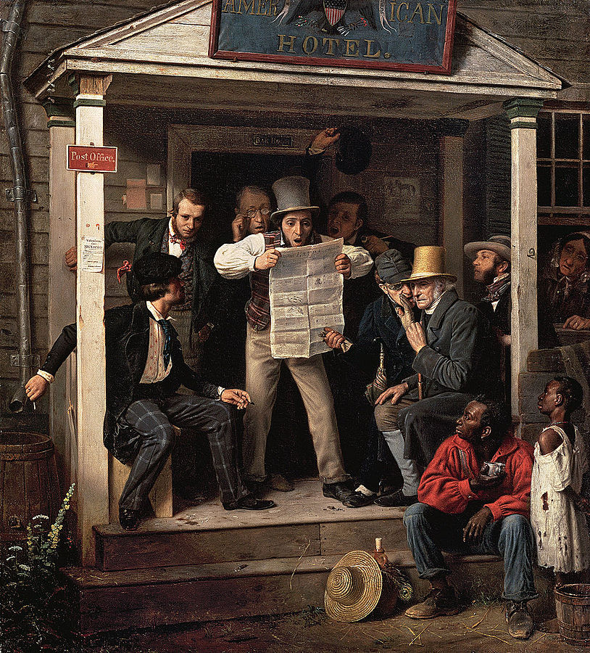
Most in Texas want to be annexed into the US
After much debate in the US, Texas was annexed in 1845
Mexico still considered it part of its territory so war was certain
Notes:
Painting is “War News from Mexico” (1848) by Richard Caton Woodville

Slide 14
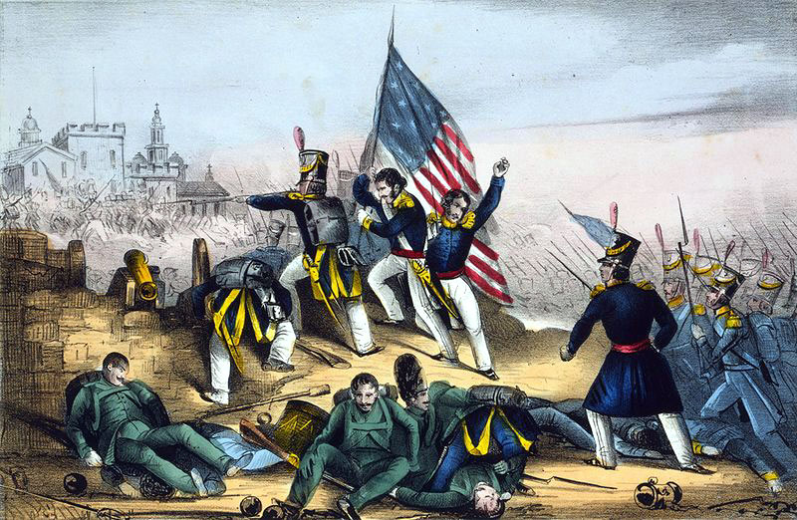
US forces capture New Mexico, California, and Northwest Mexico
The war lasts only 20 months
Victory helps the United States reach goal of Manifest Destiny

Slide 15
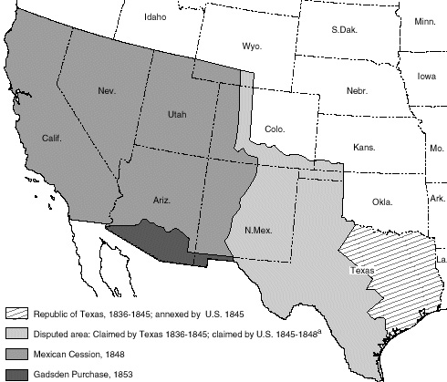
Mexico agreed to accept the Rio Grande River as the north border of Texas
2. Mexico recognized that Texas was part of the US
3. CEDED: Mexico gave up a large stretch of land between Texas and the Pacific

Slide 16
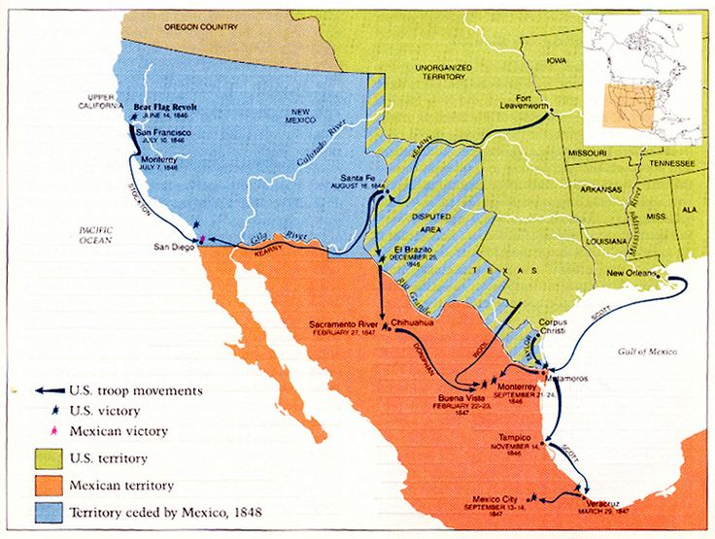

Slide 17
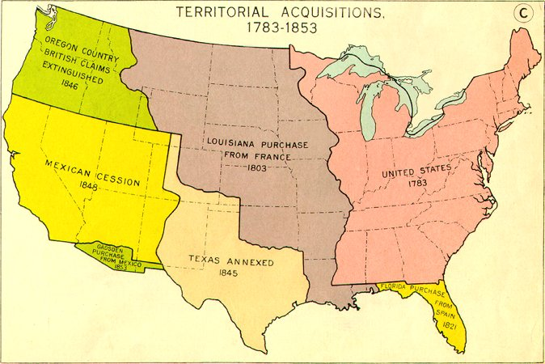

Slide 18
© Students of History - https://www.teacherspayteachers.com/Store/Students-Of-History
Notes:
Picture shows Portsmouth Square in San Francisco during the Gold Rush, 1851.

Slide 19
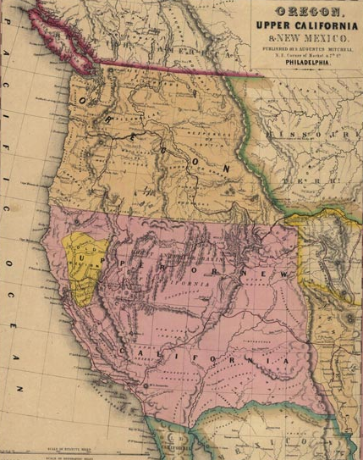
Part of the Mexican territory of Alta California
Occupied by the US since the Mexican-American War
Ceded to the US in the Treaty of Guadalupe Hidalgo on February 2, 1848
Notes:
Image shows an 1847 map of Mexico including Upper California and Oregon.

Slide 20
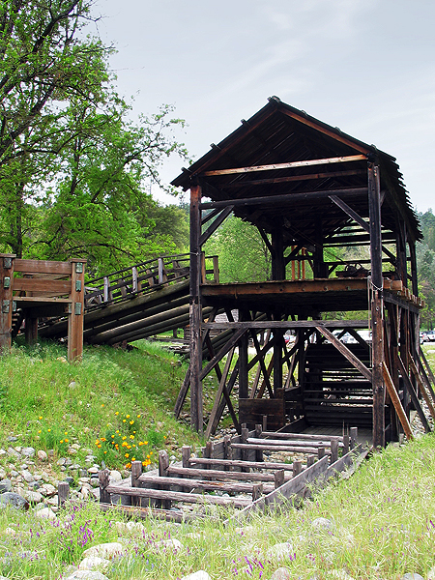
Sawmill in Soloma, a small town northeast of Sacramento
James Marshall, a man working the mill, accidently found gold in January 1848
The land’s owner, John Sutter wanted to keep the discovery a secret
Rumors spread and within a few months news spread across the US

Slide 21
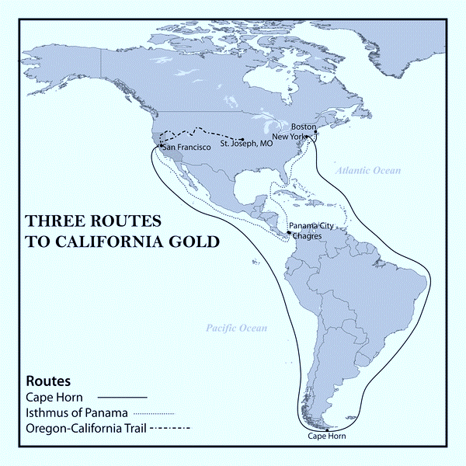
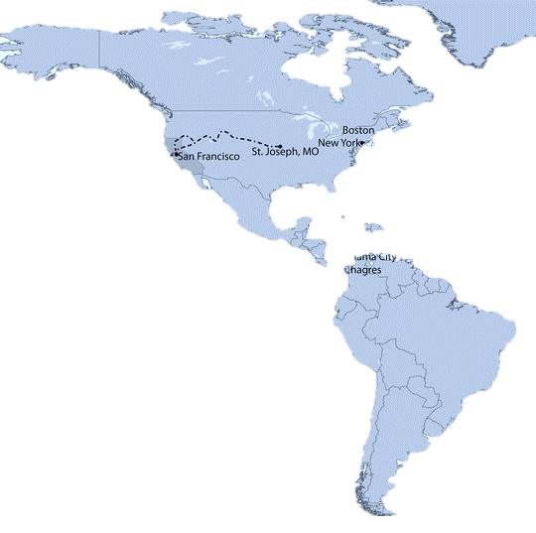
In 1849, thousands of men headed to California from across the world
Most took the Oregon and California Trails
Others took ships around Cape Horn or through the Panama Shortcut

Slide 22
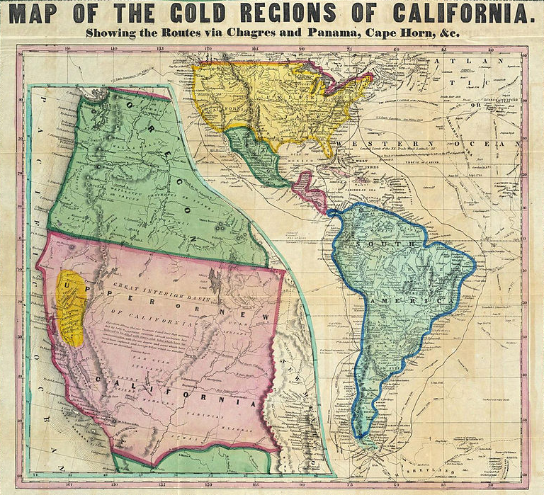
Cape Horn
18,000 miles
4-8 months
$100-$300
Panama Shortcut
7,000 miles
2-3 months
$250-$400
Overland Trails
3,000 miles
3-7 months
$100-$200
Notes:
I use this slide for a short discussion on which route students would choose. The costs and lengths of time and costs vary greatly based on weather, the experience of those leading the trips, supplies, etc. I also have students think about the dangers of each (shipwrecks and storms around Cape Horn, disease and danger through Panama, Indian attacks on the trail, etc.

Slide 23
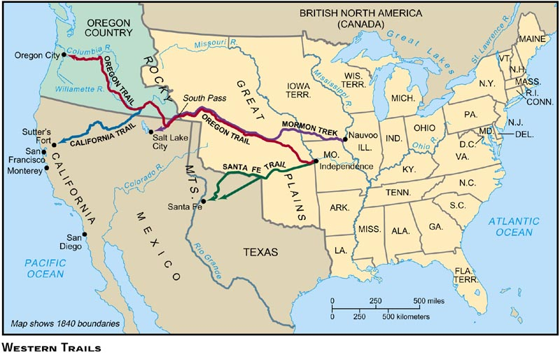
Notes:
Better view of the specific trails westward in the US.

Slide 24
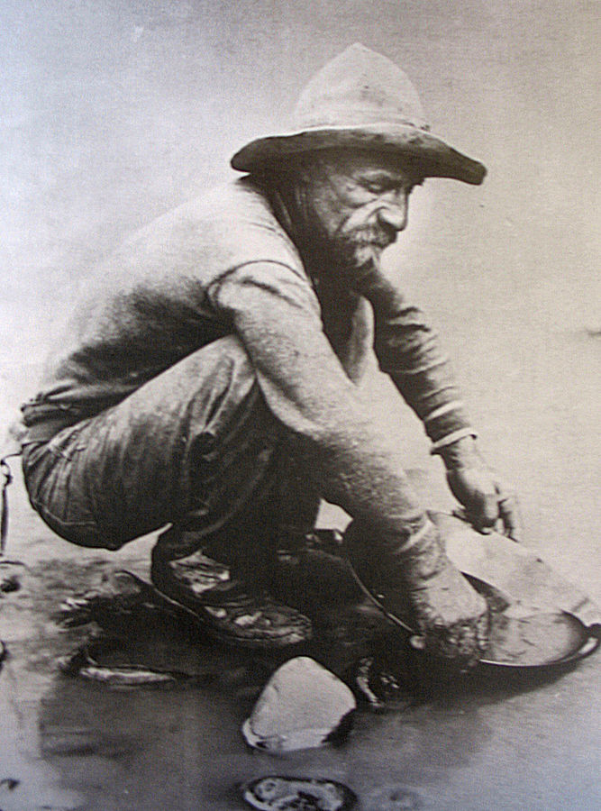
Farmers & others who left to find gold in 1849
A successful farmer might make $300 a year
Mining for gold offered the (slim) chance at $25 a day

Slide 25
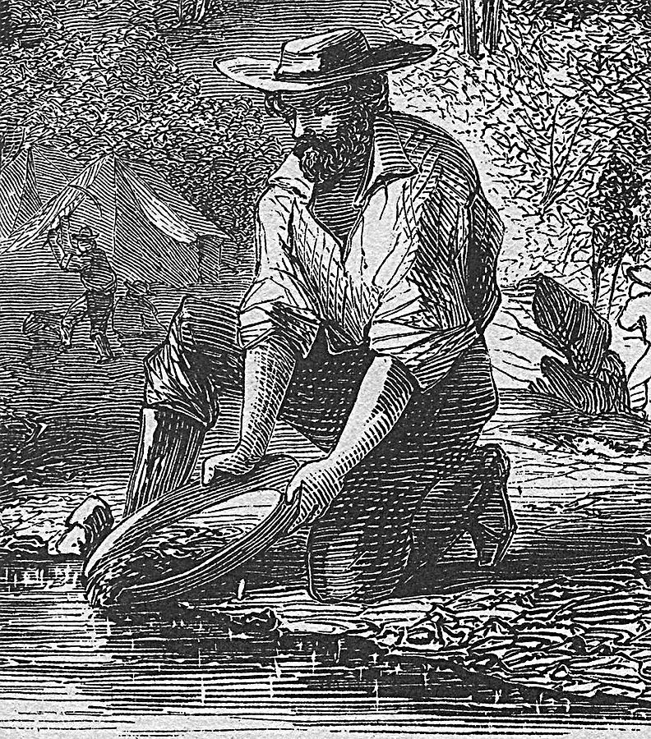
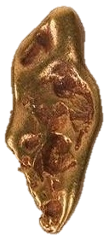
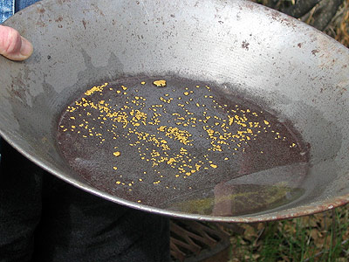
Most might find only gold flakes and do not strike it rich
Often they give up and find other work after a few months

Slide 26
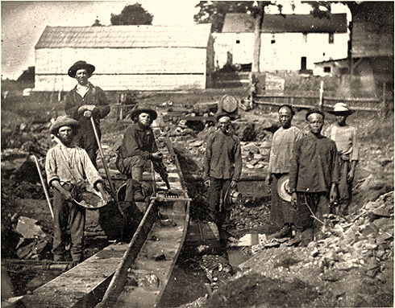
Chinese escaping war & poverty
Europeans and Latin Americans seeking riches
Most experience discrimination and scapegoating for others failures
Notes:
Photo shows both white and Chinese gold miners posing during the Gold Rush at the Auburn Ravine in 1852.

Slide 27
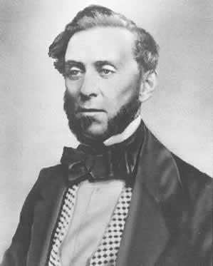
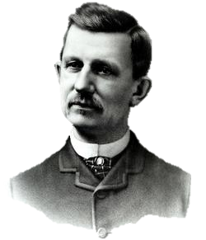
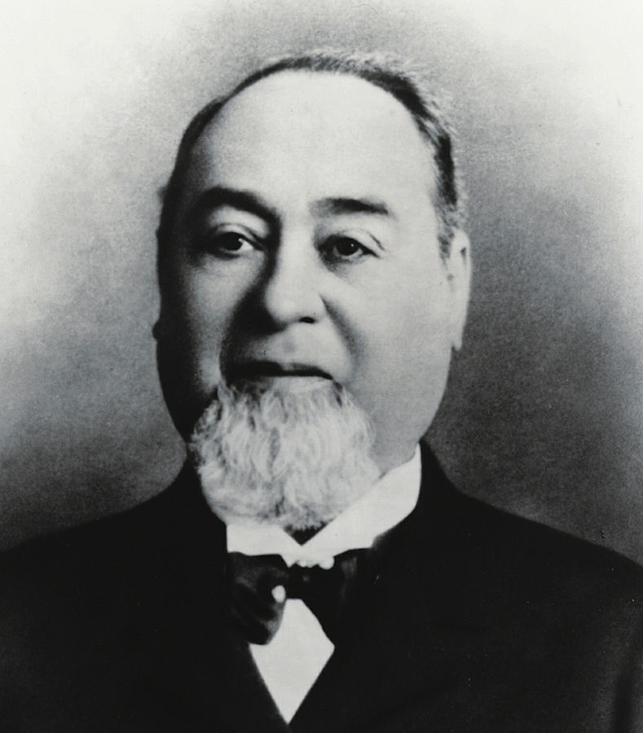
Samuel Brannan – sold supplies to miners and became 1st Californian millionaire
J.A. Folger founded a coffee firm in San Francisco (Folger’s coffee today)
Levi Strauss – manufactured and sold the 1st blue jeans
Sam Brannan
JA Folger
Levi Strauss

Slide 28
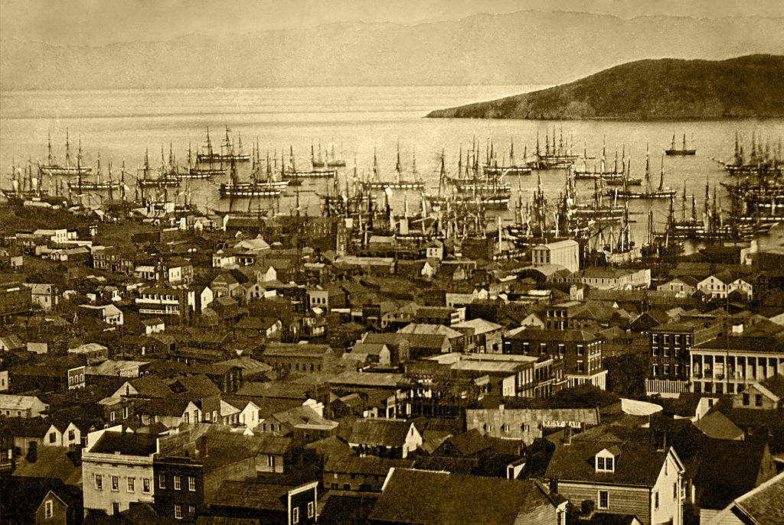
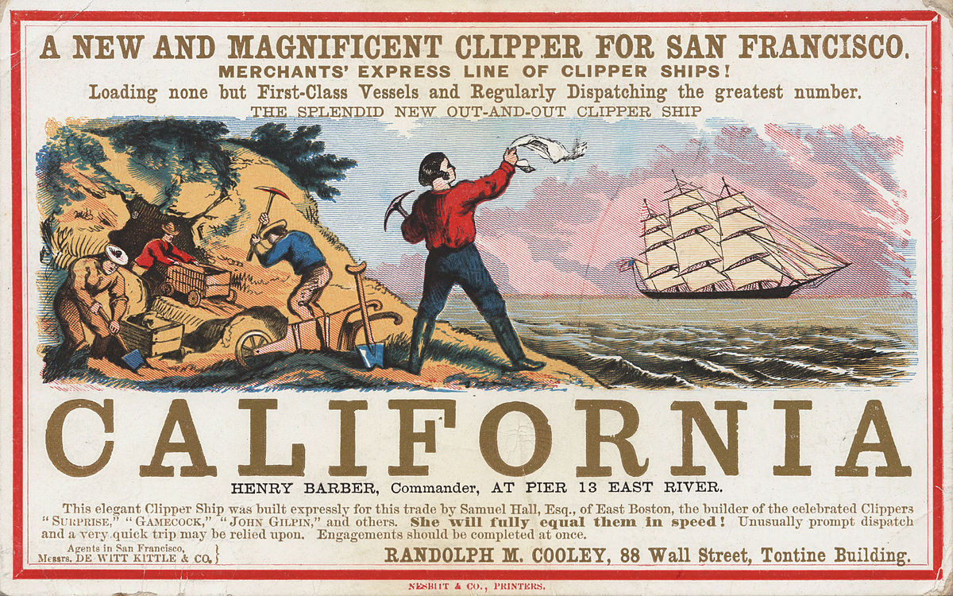
Arrival point for most 49ers
Population of non-natives explodes from about 200 to over 36,000

Slide 29
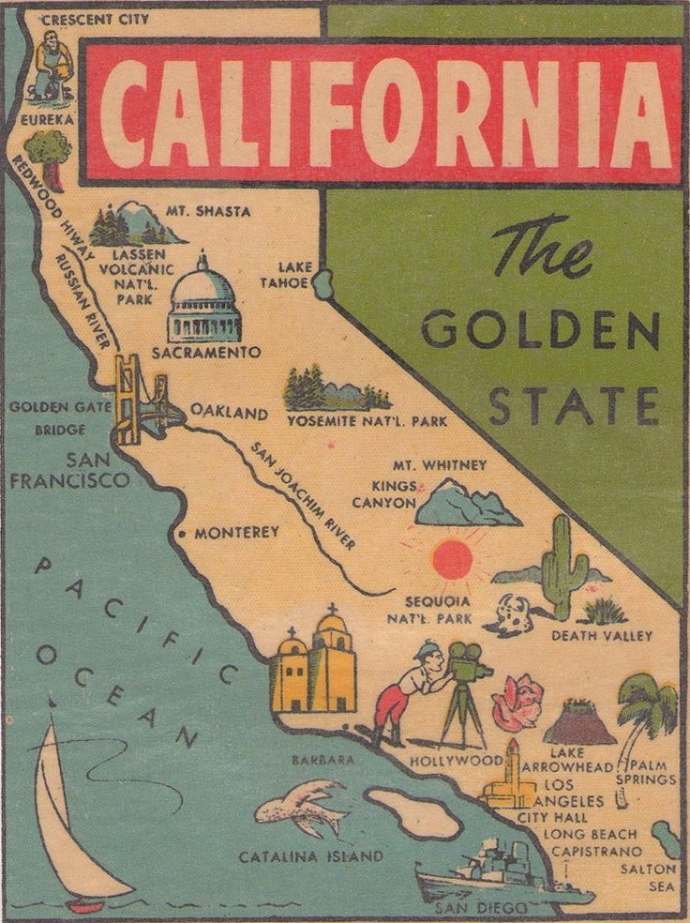
California becomes a state in 1850
Enters as a free (non-slave owning) state
Upsets the balance of free-slave state representatives in Congress

Slide 30
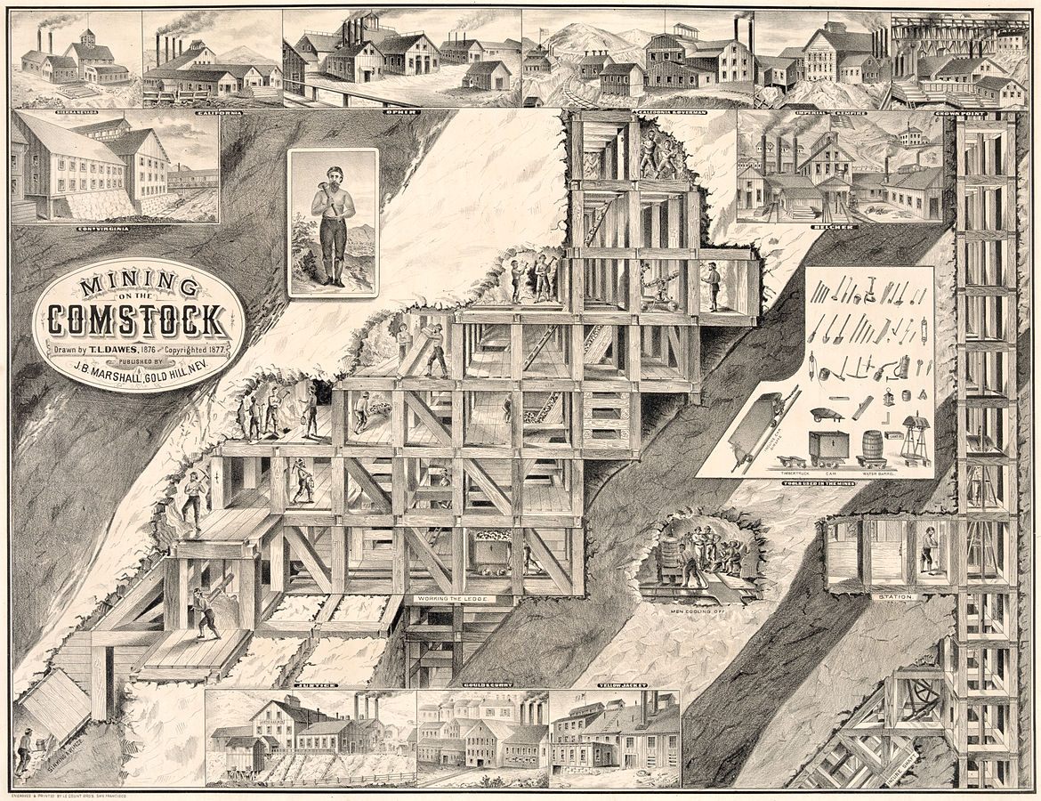
1859 discovery of silver in Nevada/Utah Territory
Sparks a new silver rush and an end to the California gold rush

