Slide 1
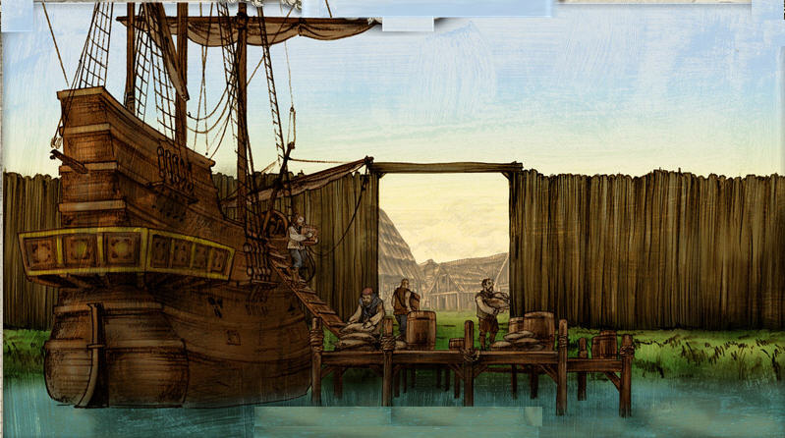
Warm Up
Push factors are reasons for moving out of a place and pull factors are things that attract immigrants.
Identify 3 push or pull factors that brought immigrants to the New World and 3 that attract immigrants to the US today.

Slide 2
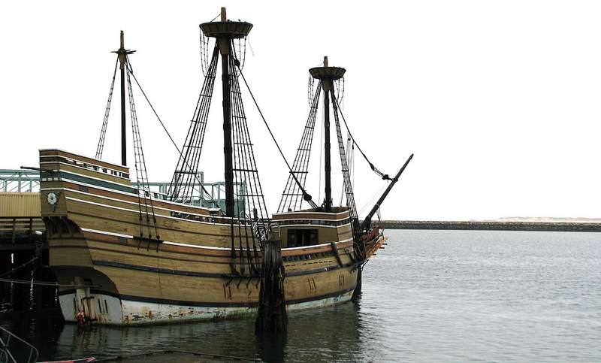
Remember?
Strict religious separatists first leave England in 1620

Slide 3
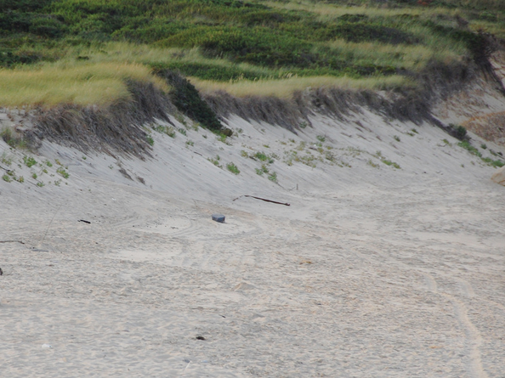
Thin, rocky soil not great for farming
Short growing season & cold winters
More mountainous inland than Southern America

Slide 4
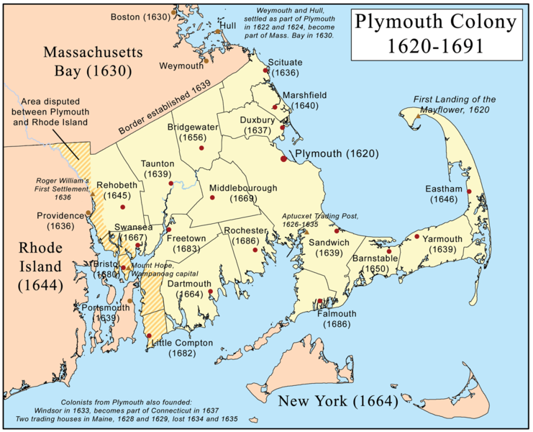
Look at all the English towns popping up in this area….what does this imply about English Colonization?

Slide 5
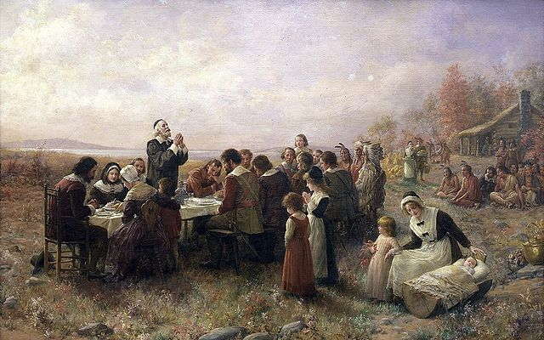
A Wampanoag named Squanto taught the pilgrims to fish & grow corn In return for helping to fight their enemies (the Narragansett)
In 1621, Pilgrims & Native Americans supposedly held the 1st Thanksgiving Feast

Slide 6
This painting was made in 1932 while the event happened in 1621.
What do you see in this picture?
Does the date it was made change the accuracy of this picture?
What is the purpose of this picture?

Slide 7
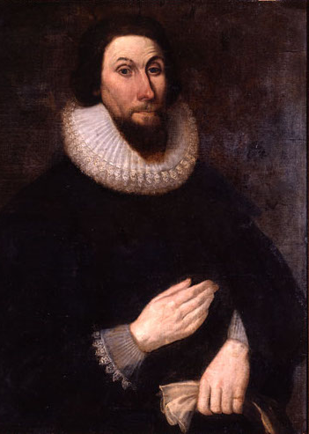
In 1628, he becomes Governor of the larger Massachusetts Bay Colony
Wished to create a “City Upon a Hill” which is like a Puritan utopia.
Utopia: an imagined place or state of things in which everything is perfect.

Slide 8
Religious leaders do not accept any dissent
Dissent: Having opinions different than what is popular.
Roger Williams - banished for giving his opinions in church, founds Rhode Island

Slide 9
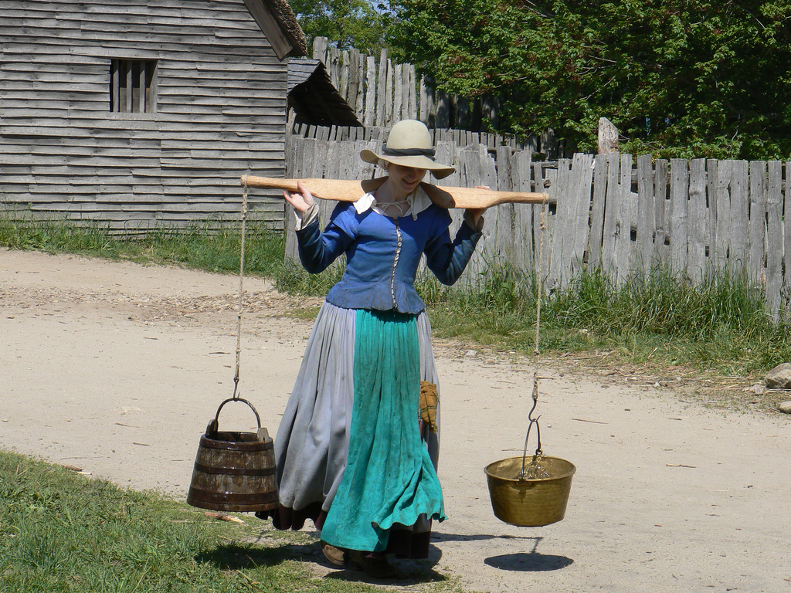
Women were supposed to be subservient to men
Anne Hutchinson - banished for holding bible meetings for women, moves to Rhode Island

Slide 10
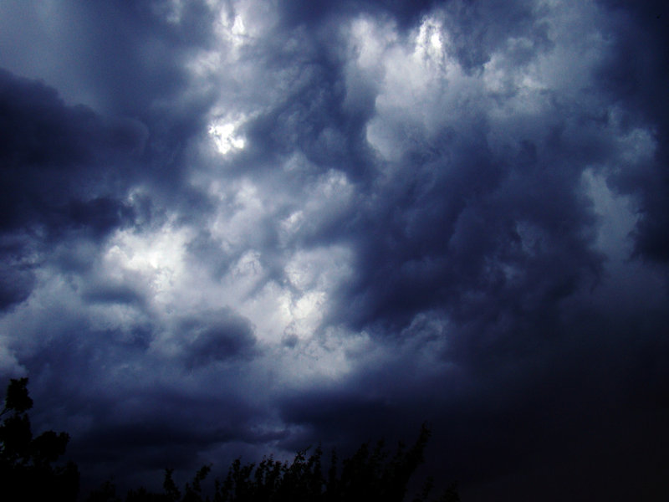
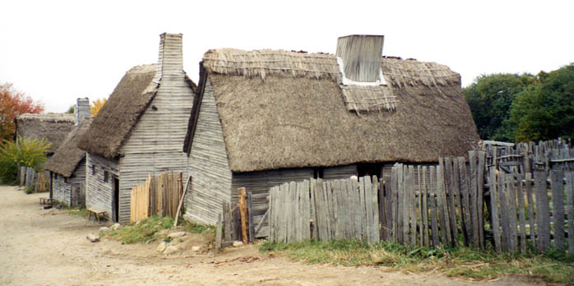
In 1692, several young Puritan girls seem bewitched
Over 100 people (mostly women) are arrested and tried for witchcraft
20 are executed for witchcraft, most by hanging

Slide 11
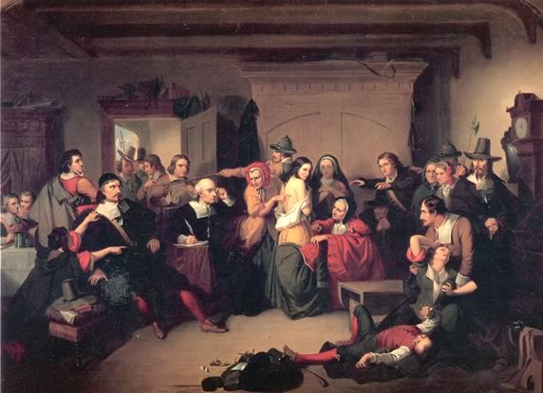
Examination of a Witch – the court looked for birthmarks which were thought to be made by the Devil

Slide 12
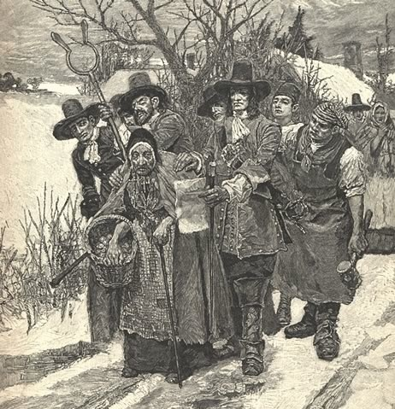
Many of those accused are single, independent women who go against Patriarchal Puritan society
Patriarch-society in which men make the decisions.
Many of those accused are single, independent women who go against Patriarchal Puritan society

Slide 13
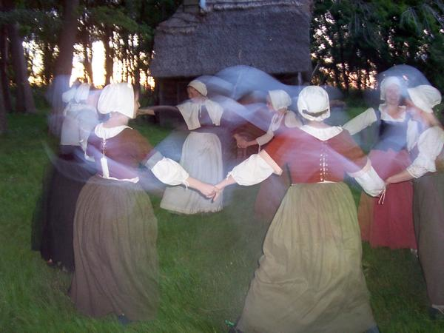
Fear of independent women
Challenges to Puritan authority
Rigid structured society

Slide 14
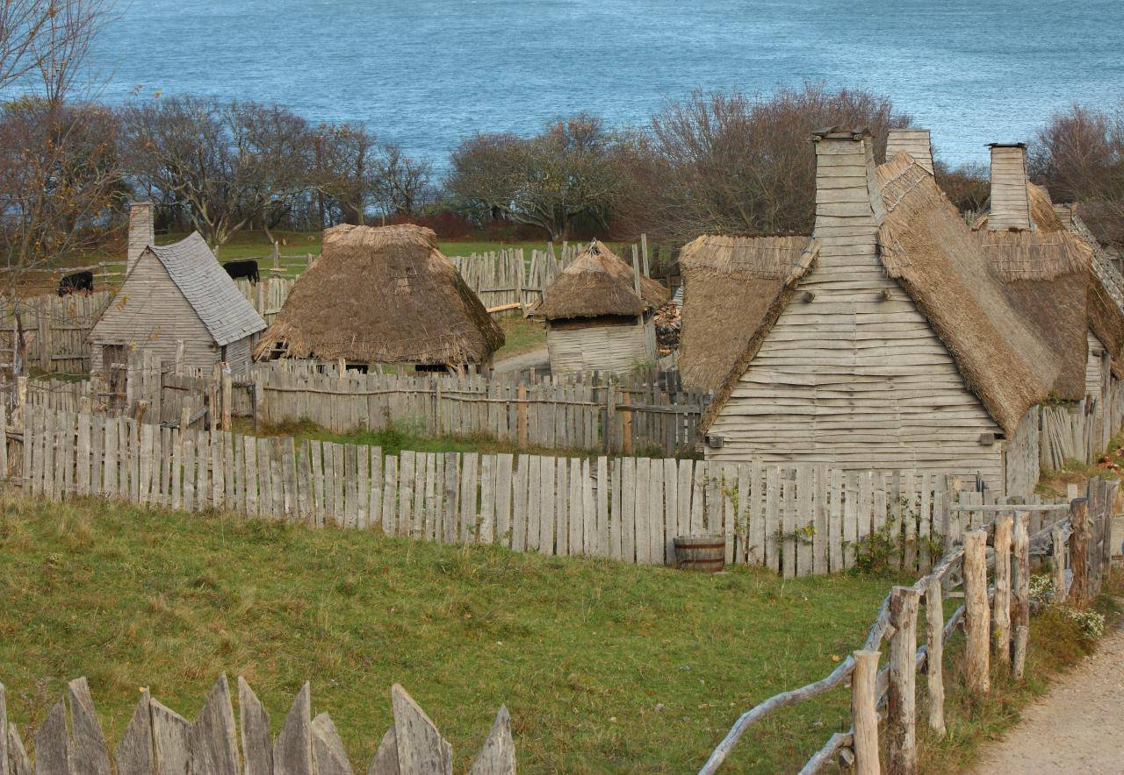
Economy grows based on shipbuilding, fishing, & trade
Colonies spread to the Connecticut River & New Hampshire

