Slide 1
Slavery

Slide 2
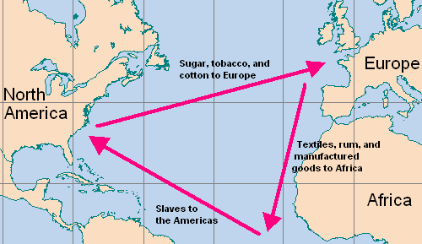
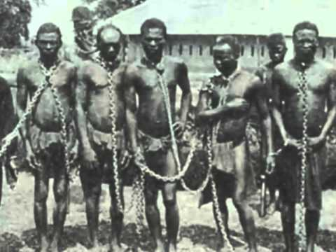
The Beginning
Triangle Trade
How did an African become a slave?
1: the slaves were taken as prisoners during the frequent tribal wars occurring among the West African kingdoms.
2: became slaves as punishment for crimes or indebtedness
Transported to coast to sell

Slide 3
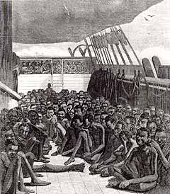
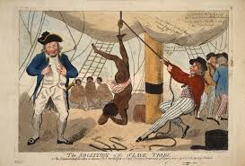
Middle Passage
The stage of the triangular trade in which millions of Africans were shipped to the New World as part of the Atlantic slave trade

Slide 4
Life on the Boat
about 10-15 percent of the Africans died; the longer the voyage lasted, the higher the death rate. Estimates vary, but up to 2 million died (smallpox, measles, malaria, and dysentery.)
Diet- One cup boil beans or rice, One pint water
“They are frequently stowed so close, as to admit of no other posture than lying on their sides. Neither will the height between decks ... permit them the indulgence of an erect posture; especially where there are platforms, which is generally the case. These platforms are a kind of shelf, about eight feet in breadth, extending from the side of the ship towards the center. They are placed nearly midway between the decks, at the distance of two or three feet from each deck. Upon these the negroes are stowed in the same manner as they are on the deck [floor] underneath.” -Alexander Falconbridge, an English slave ship doctor

Slide 5
https://www.youtube.com/watch?v=0IJrhQE6DZk&t=55s

Slide 6
Slave Uprisings
Many slave ships were worried about uprising from the slaves.
Man chained down at all times
Uprising were very common, slaves felt it was better to die.

Slide 7
https://www.youtube.com/watch?v=z1uBbANeSqQ&t=1s

Slide 8
Selling Slaves in America
Before selling his slaves, a captain did everything he could to improve the price he would get for them. The Africans received increased food and water rations, and their skins were rubbed with palm oil to give them a healthy appearance. The ship’s doctor tried to hide scars or evidence of disease, sometimes using cruel or painful cosmetic techniques.
Two ways of selling:
Auction
Scramble

Slide 9
https://www.youtube.com/watch?v=TnHKwtXEVTQ&t=22s

Slide 10
Slaves in America
Infant Mortality rate: 50% for slaves 25% for whites
Life expectancy: 22 for slaves 43 for whites
Chronic undernourishment
diet lacked protein, thiamine, niacin, calcium, magnesium, and vitamin D, and as a result, slave children often suffered from night blindness, abdominal swellings, swollen muscles, bowed legs, skin lesions, and convulsions
Laboring 15-16 hours a day
Because slaves had no direct incentive to work hard, slaveowners combined harsh penalties with positive incentives. Some masters denied passes to disobedient slaves. Others confined recalcitrant slaves to private jails. Chains and shackles were widely used to control runaways. Whipping was a key part of plantation discipline.

Slide 11
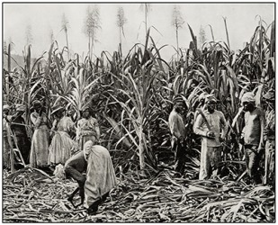
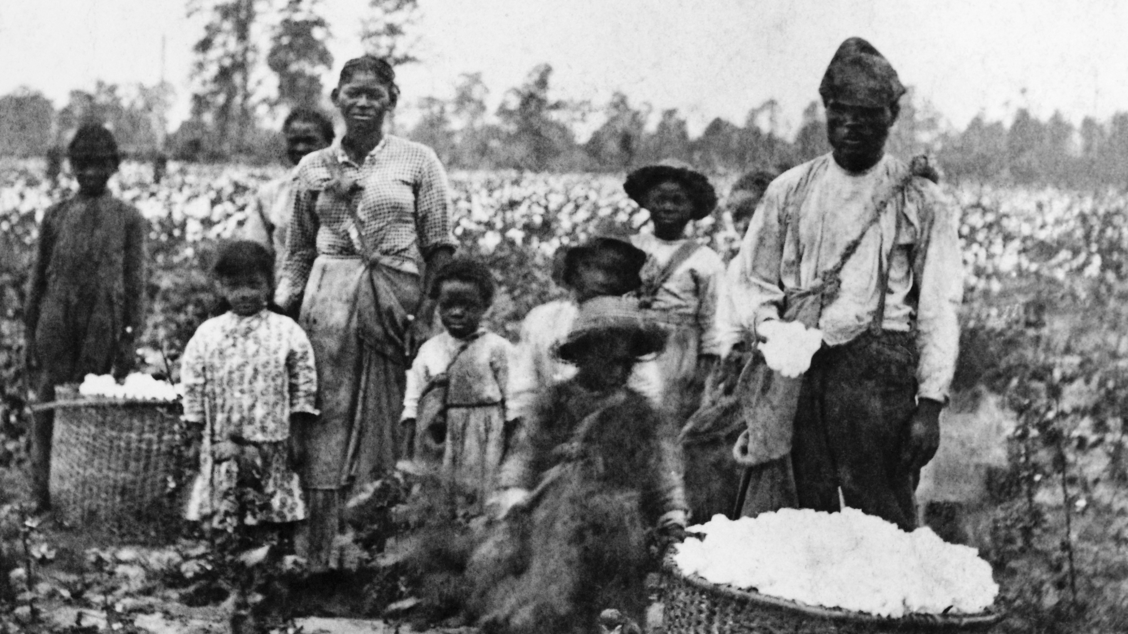
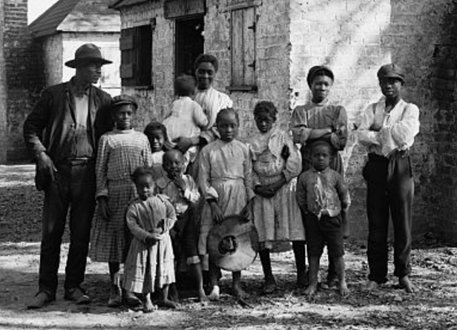
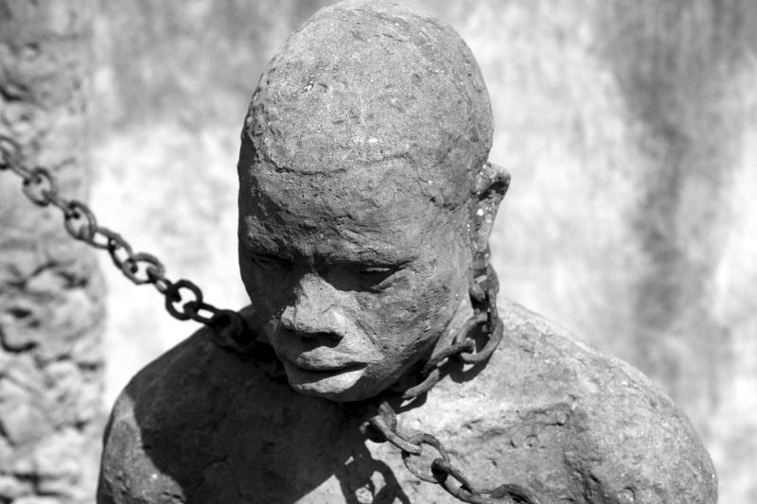

Slide 12
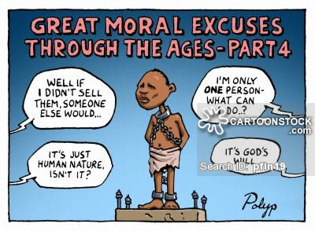
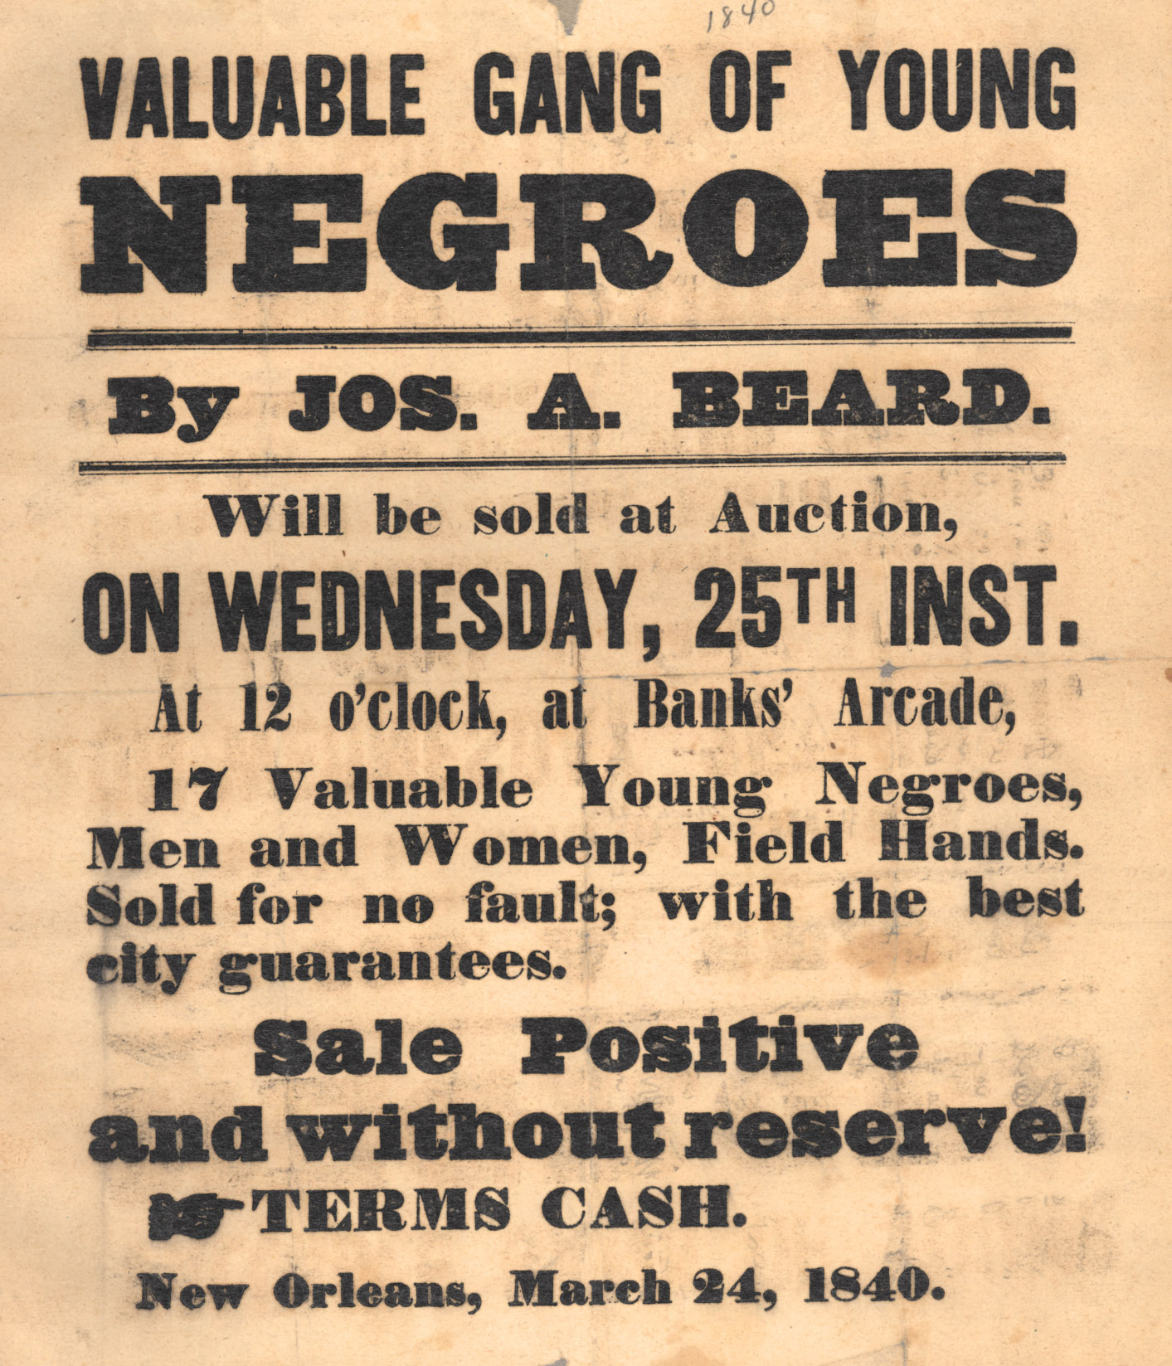
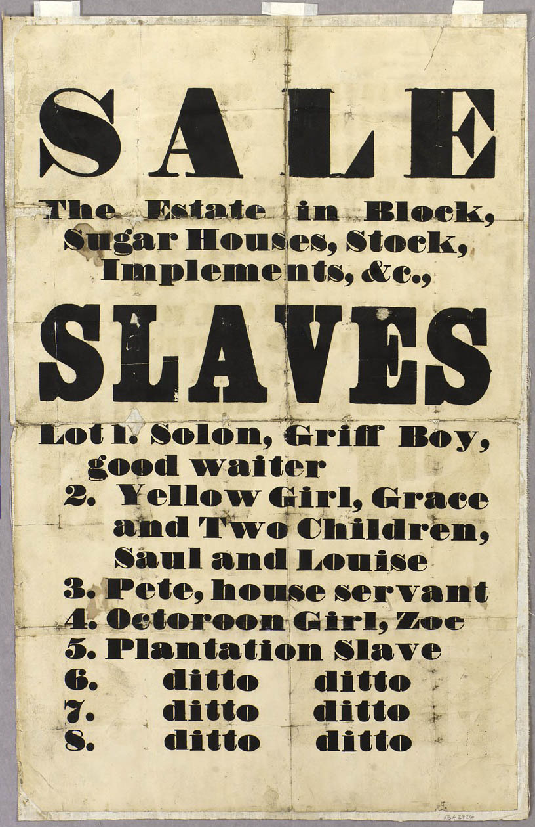
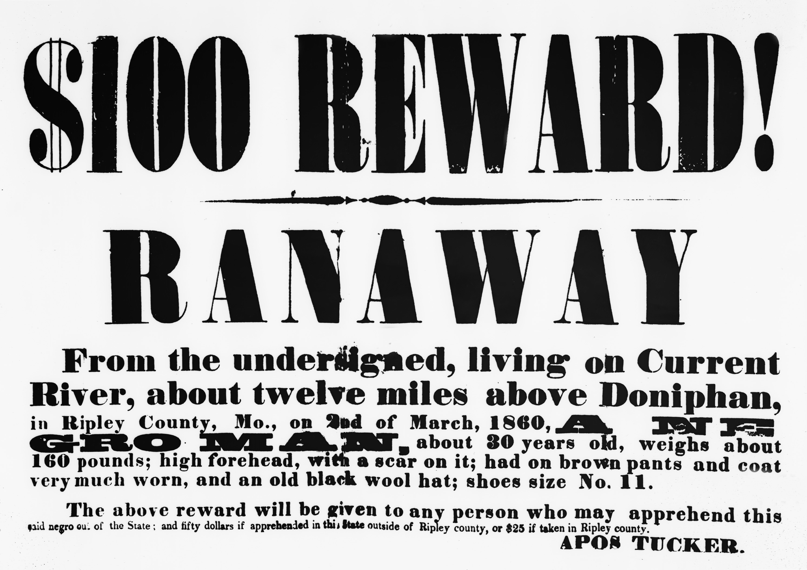

Slide 13
Read narrative

Slide 14
Underground Railroad and Abolitionists
vast network of people who helped fugitive slaves escape to the North
it effectively moved hundreds of slaves north each year.
the South lost 100,000 slaves between 1810 and 1850.
The fugitives would move at night. They would generally travel between 10 and 20 miles to the next station, where they would rest and eat, hiding in barns and other out-of-the-way places. While they waited, a message would be sent to the next station to alert its stationmaster.
Harriet Tubman, who made 19 trips into the South and escorted over 300 slaves to freedom.

Slide 15
