Slide 1
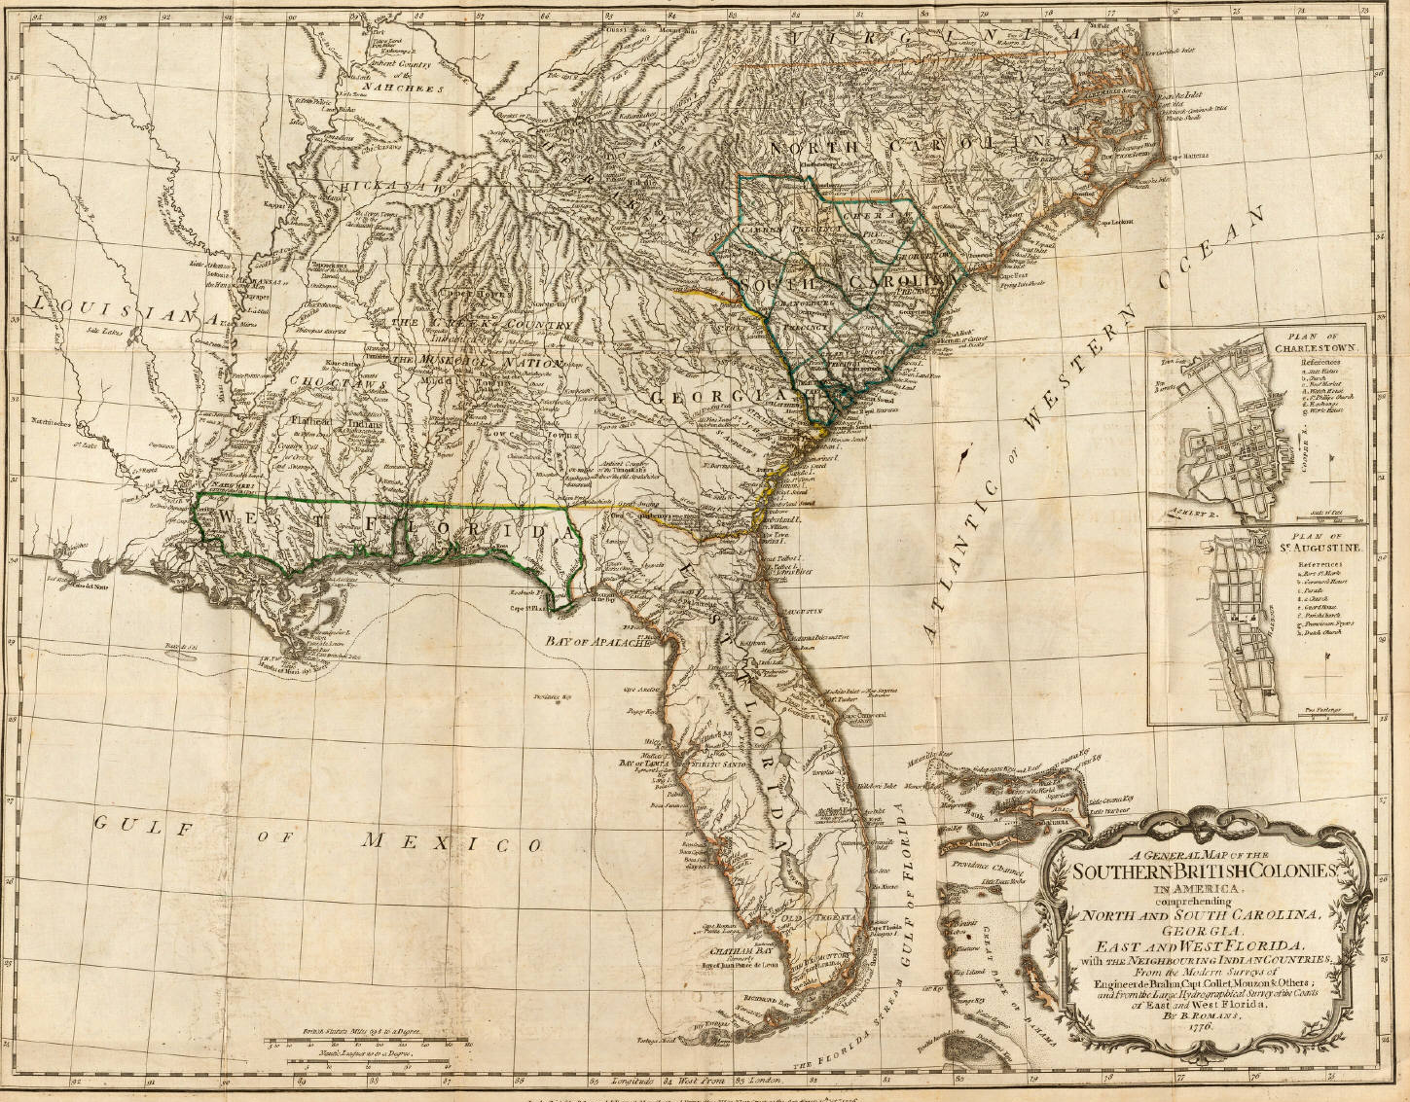

Slide 2
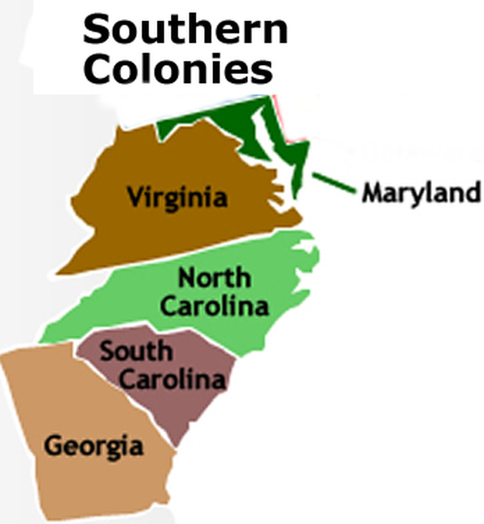
Colonies
Maryland
Virginia
North Carolina
South Carolina
Georgia

Slide 3
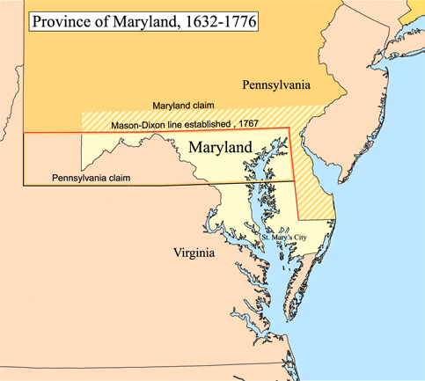
Promoted to be a refuge for Catholics
Selected St. Mary’s City as the first settlement
Representative government

Slide 4
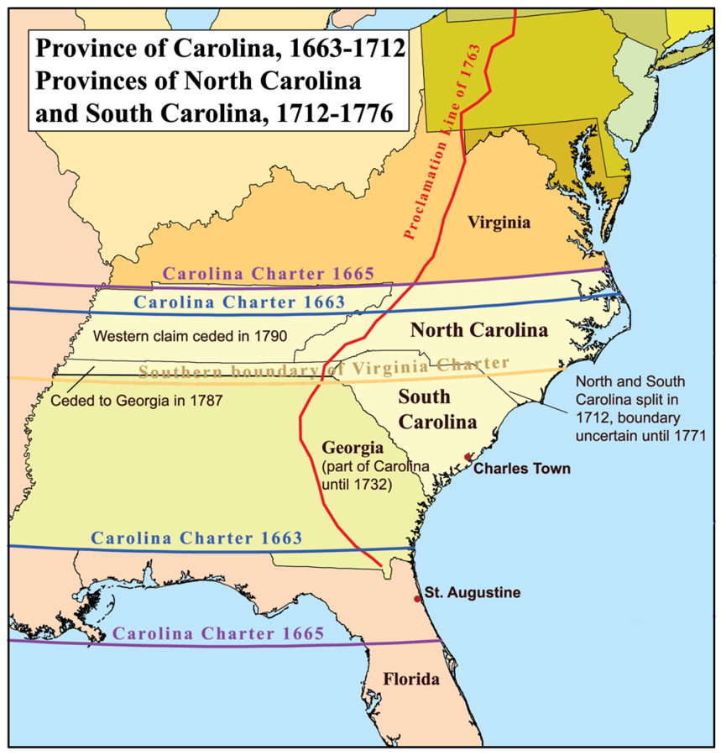
Chartered in 1663
Representative assembly
Settled by Caribbean farmers (who brought slavery to the region)
Economy based on cash crops

Slide 5
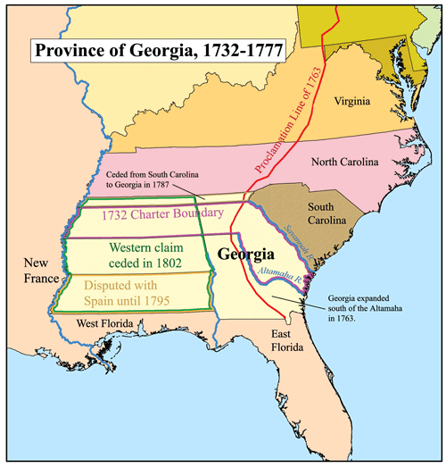
Granted a charter in 1732
Used as a criminal colony and buffer between the British and Spanish Florida

Slide 6
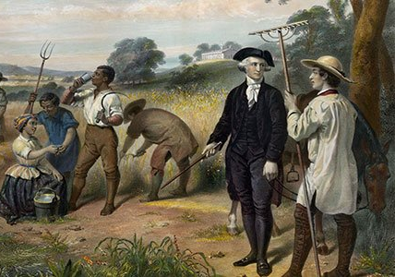
Outbreaks of malaria & yellow fever keep life expectancies low
Climate & Soil create a Tobacco Economy

Slide 7
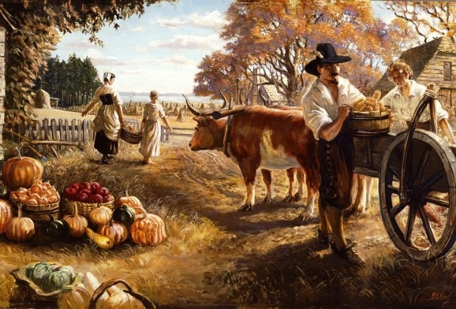
Headright System
To encourage the importation of workers
Land grants of about 50 acres per person were given to the “head” of a family
Could receive up to 1,000 acres

Slide 8
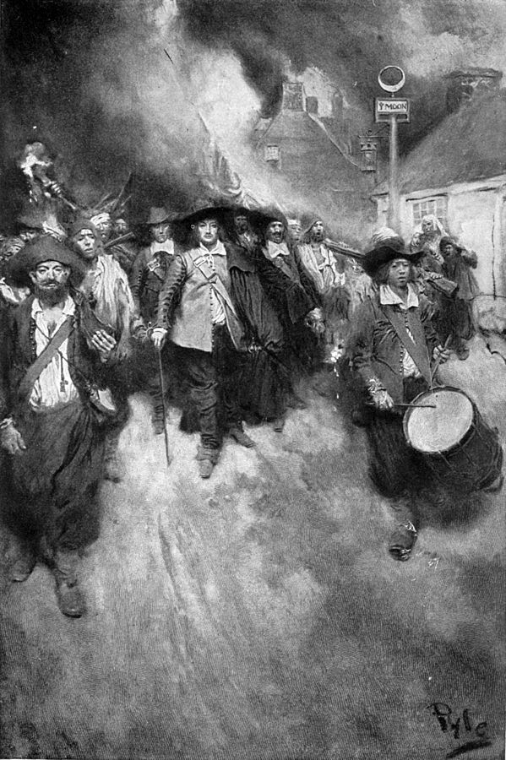
Increasing number of poor settlers frustrated by lack of good land & Indian attacks
In 1676, Nathaniel Bacon and former indentured servants led a raid on Jamestown and burned it
Governor Berkeley crushed the rebellion
Landowners begin to distrust indentured servants and import more slave labor

Slide 9
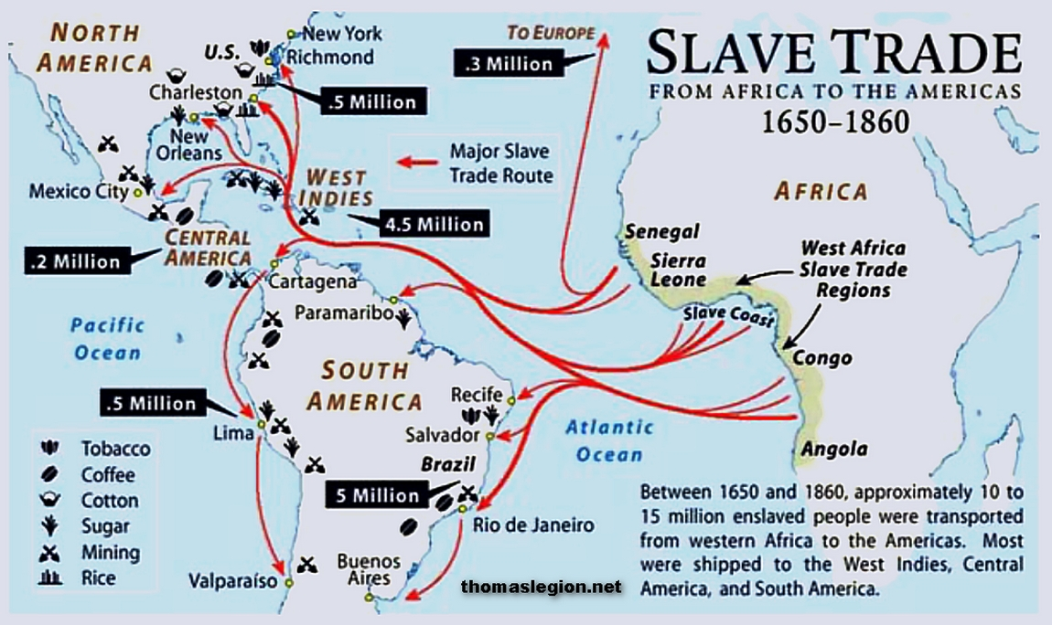
How many years did the Slave Trade go on for?
How many Africans were displaced in total? What kind of effects would the slaves have on the countries they are being sent to?

Slide 10
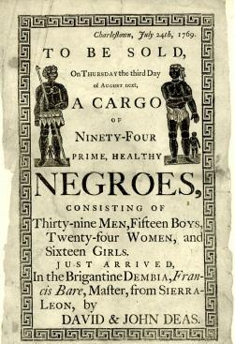
In 1698 the slave trade was open to anyone with a boat.
By the 1660s, “slave codes” were drawn up by the colonial governments to differentiate between servants’ and slaves’ rights

Slide 11
About 10 million Africans were forced to the Americas over the course of 3 centuries
First Africans came to Jamestown in 1619 (about 2,000)

